Slide 1
Social Media Site PHP
BCPR294 – Server Side Web Programming James Darley

Slide 2
Table of Contents
Website Overview
Database
Security
SOLID
Evaluation

Slide 3
MoSCoW – Must features
Handle user credentials and have a secure login system
Allow new users to register for the gaming community using an email, username and password
Profile page with unique user information
Must have a homepage with topics for the users
Ability for users to leave comments
Ability for users to send private messages
Share button with the ability to share in a private message
Allow users to add each other as ‘friends’ with increased options of interaction
Implement a search button capable of returning searches for users or page content
Must support localisation (language support)
Must be responsive on mobile devices

Slide 4
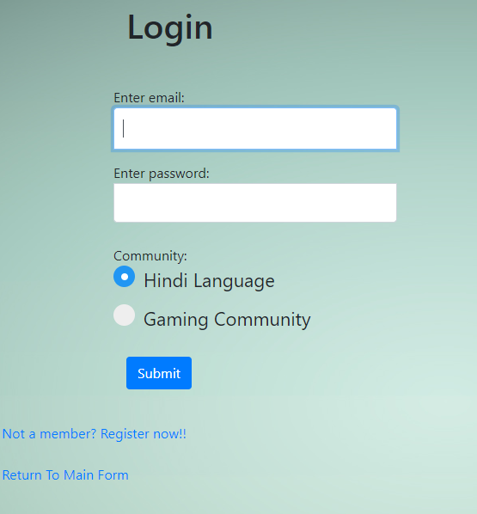
Login
Handle user login with email and password
Must return an error if login invalid
Choice of community to enter by selecting checkbox

Slide 5
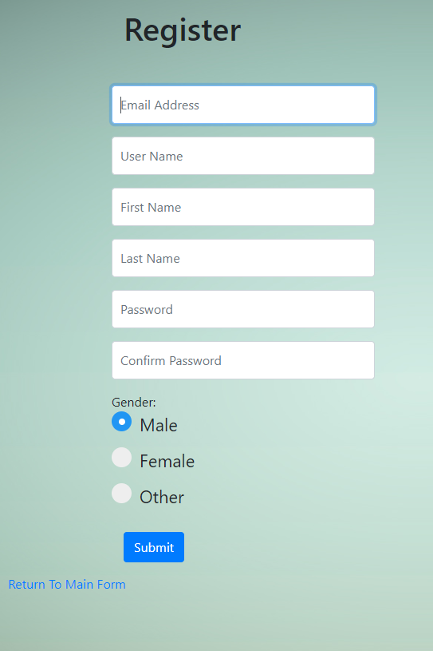
Registration
User can add a new account using email, name, username, password and gender
All fields are required to be filled out to register

Slide 6
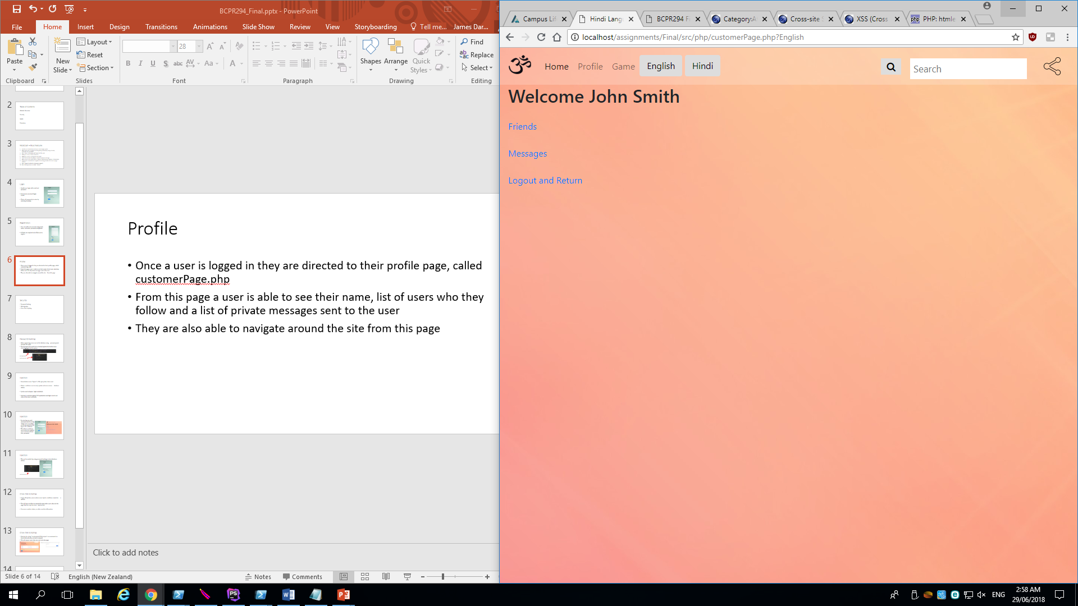
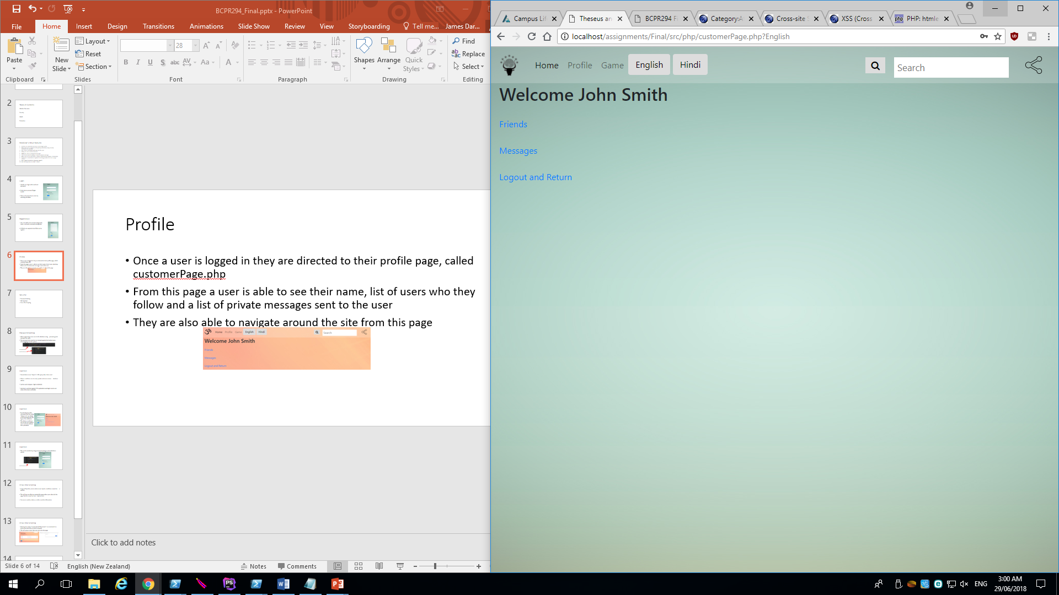
Profile
Once a user is logged in they are directed to their profile page, called customerPage.php
From this page a user is able to see their name, list of users who they follow and a list of private messages sent to the user
They are also able to navigate around the site from this page

Slide 7
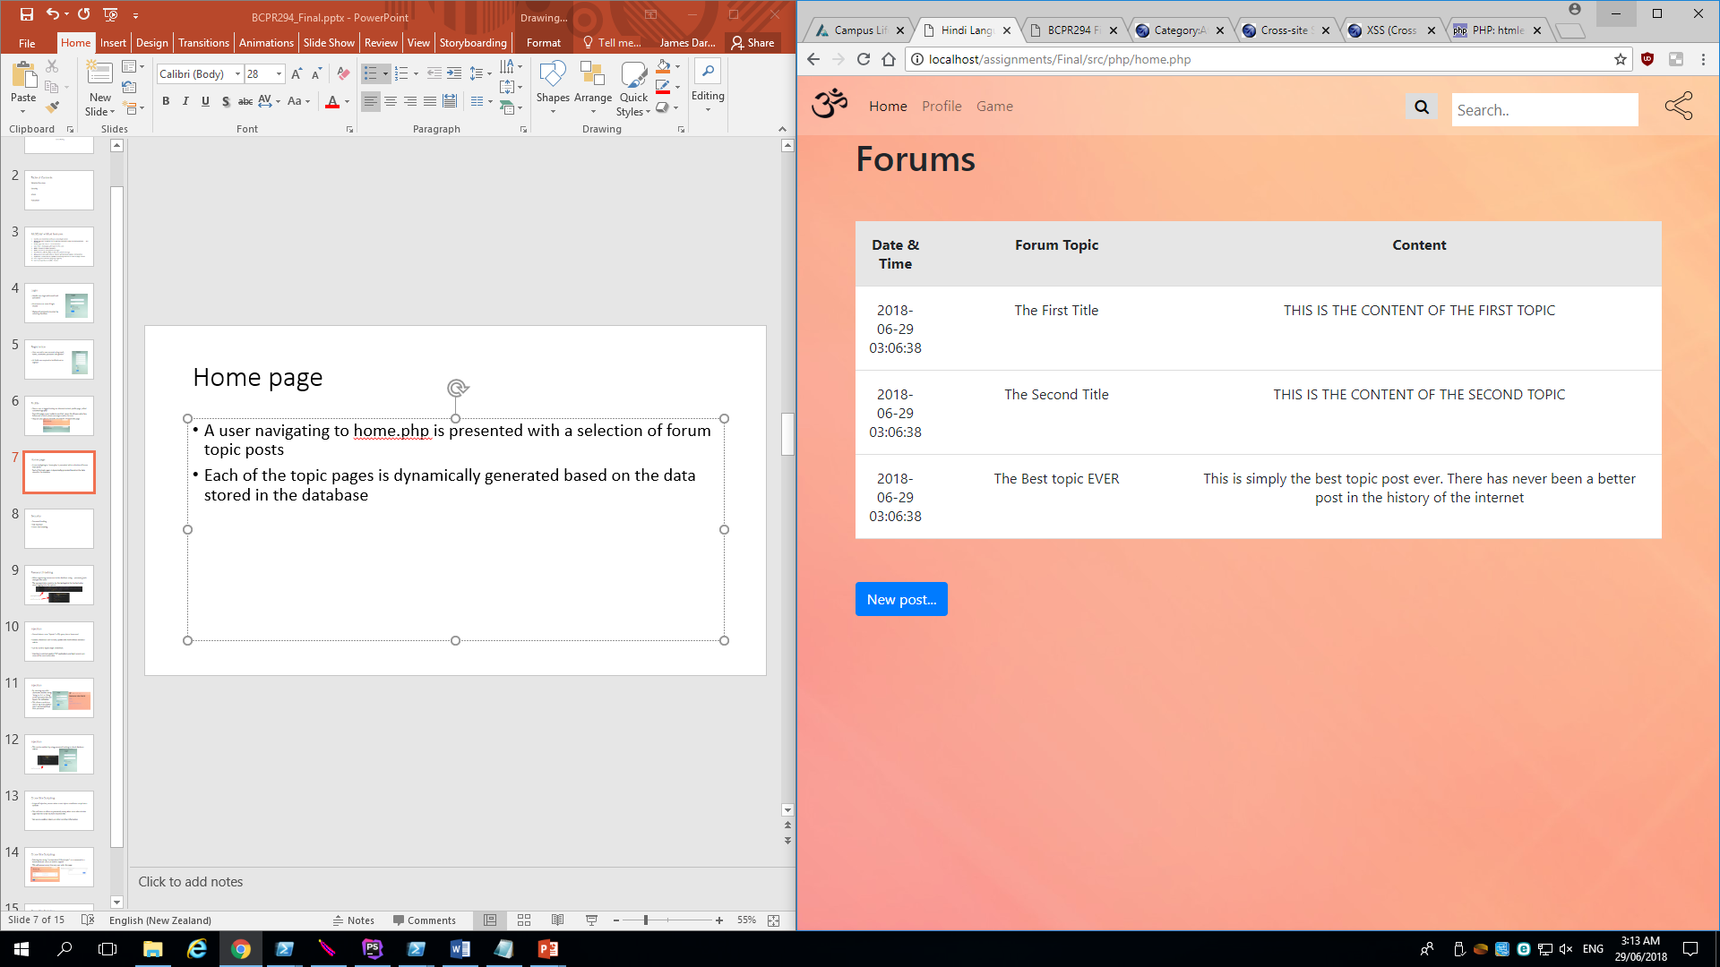
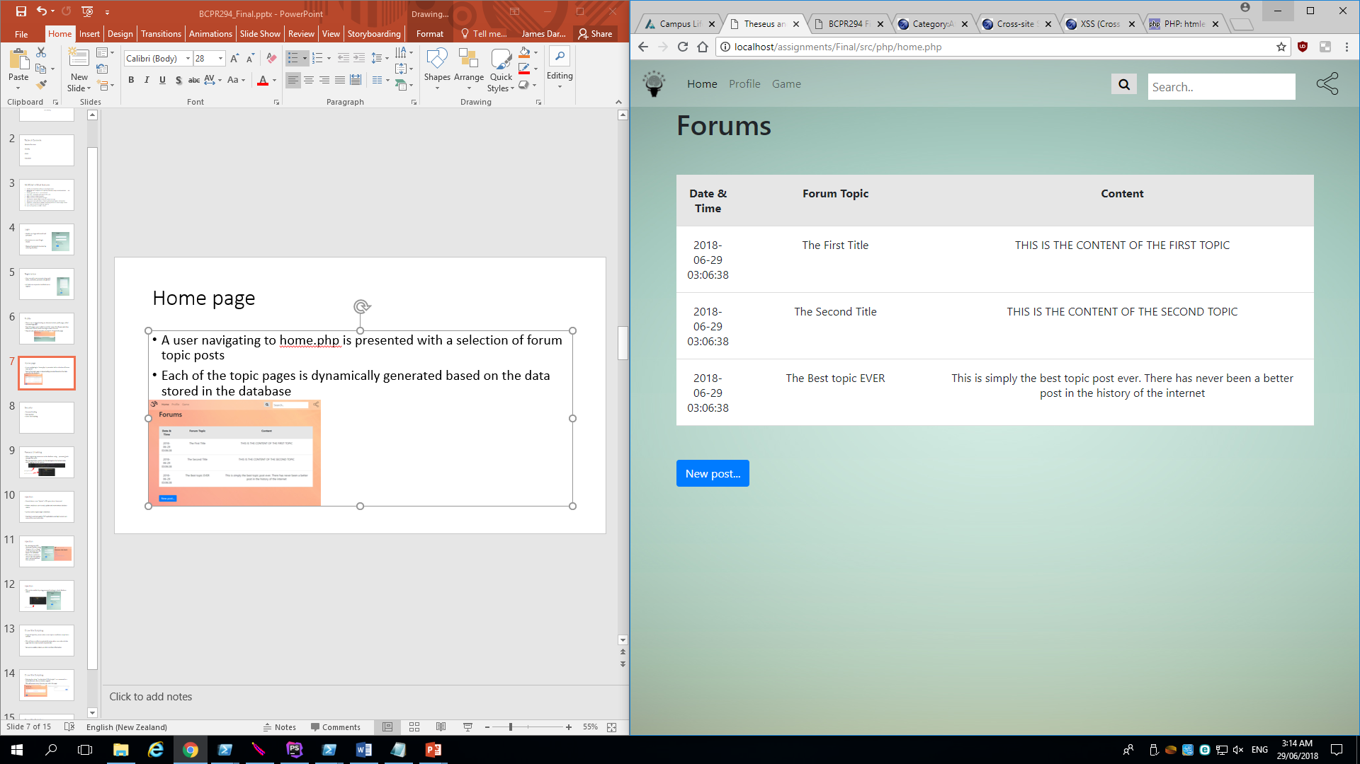
Home page
A user navigating to home.php is presented with a selection of forum topic posts
Each of the topic pages is dynamically generated based on the data stored in the database

Slide 8
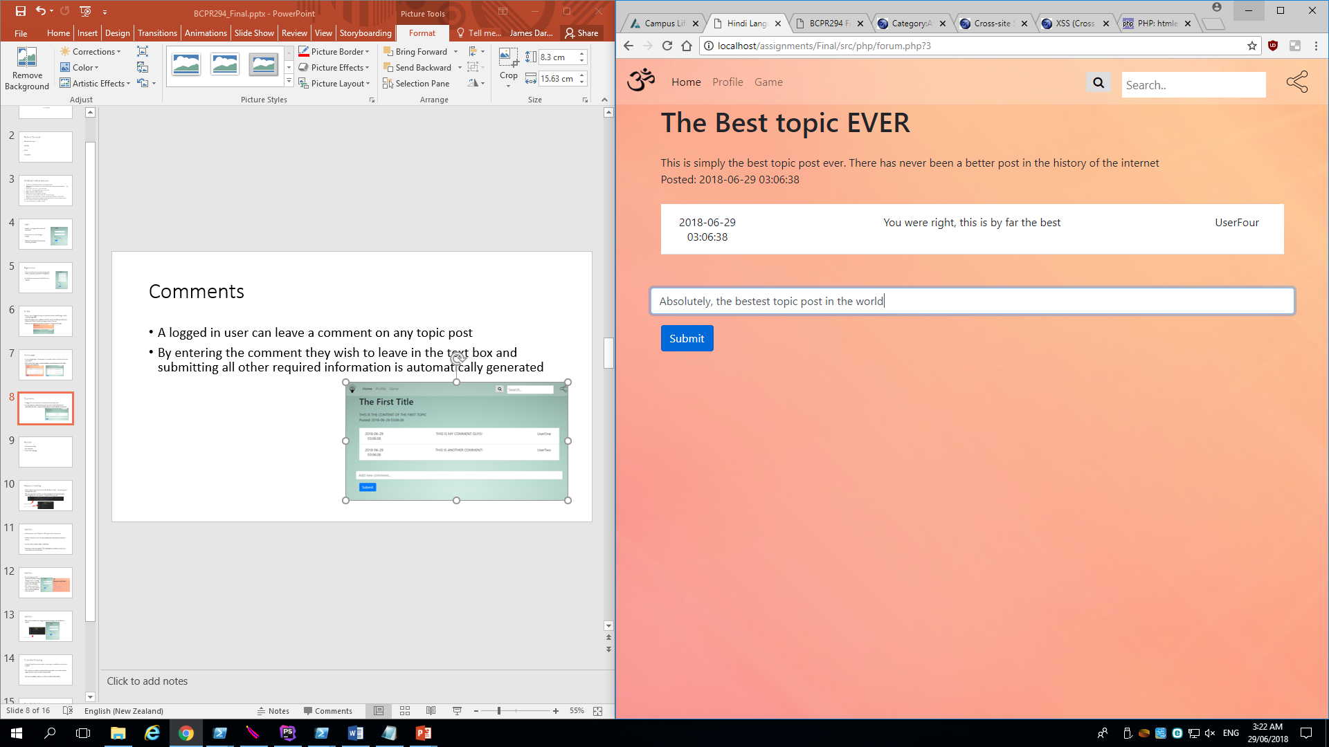
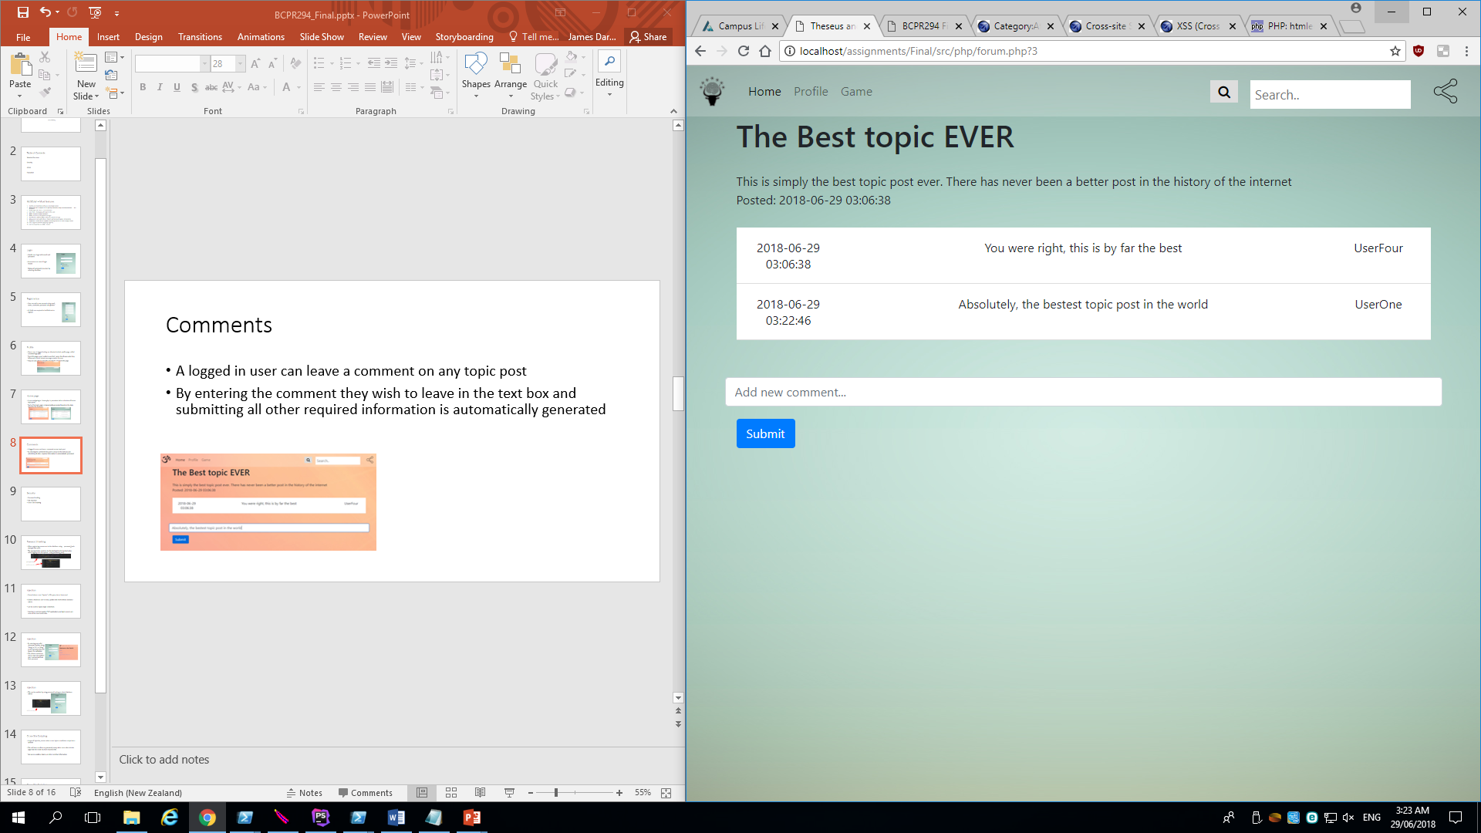
Comments
A logged in user can leave a comment on any topic post
By entering the comment they wish to leave in the text box and submitting all other required information is automatically generated

Slide 9
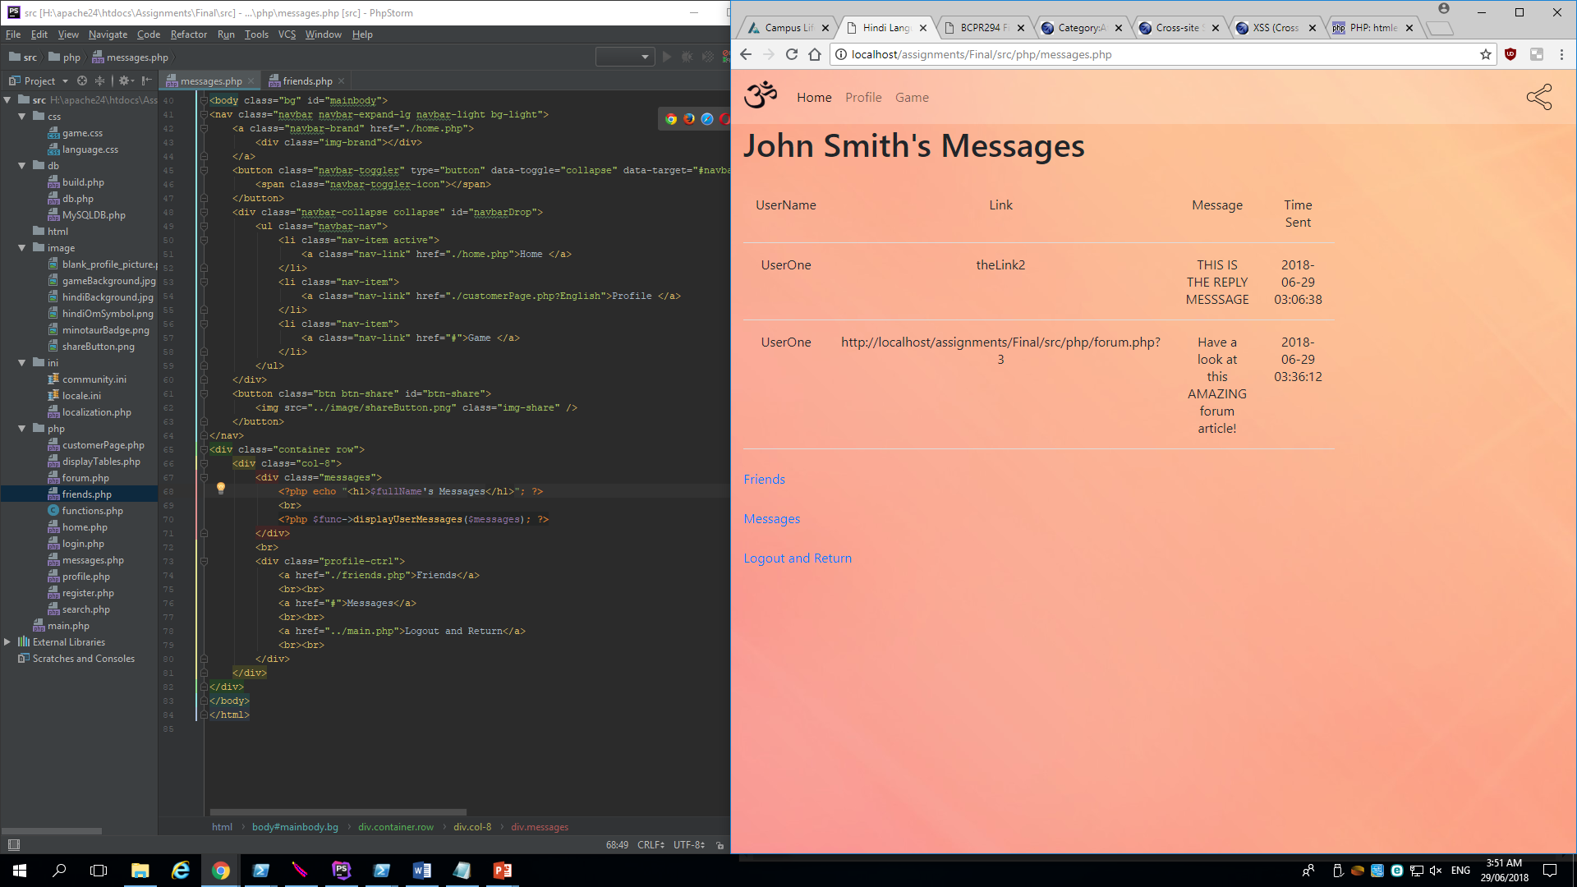
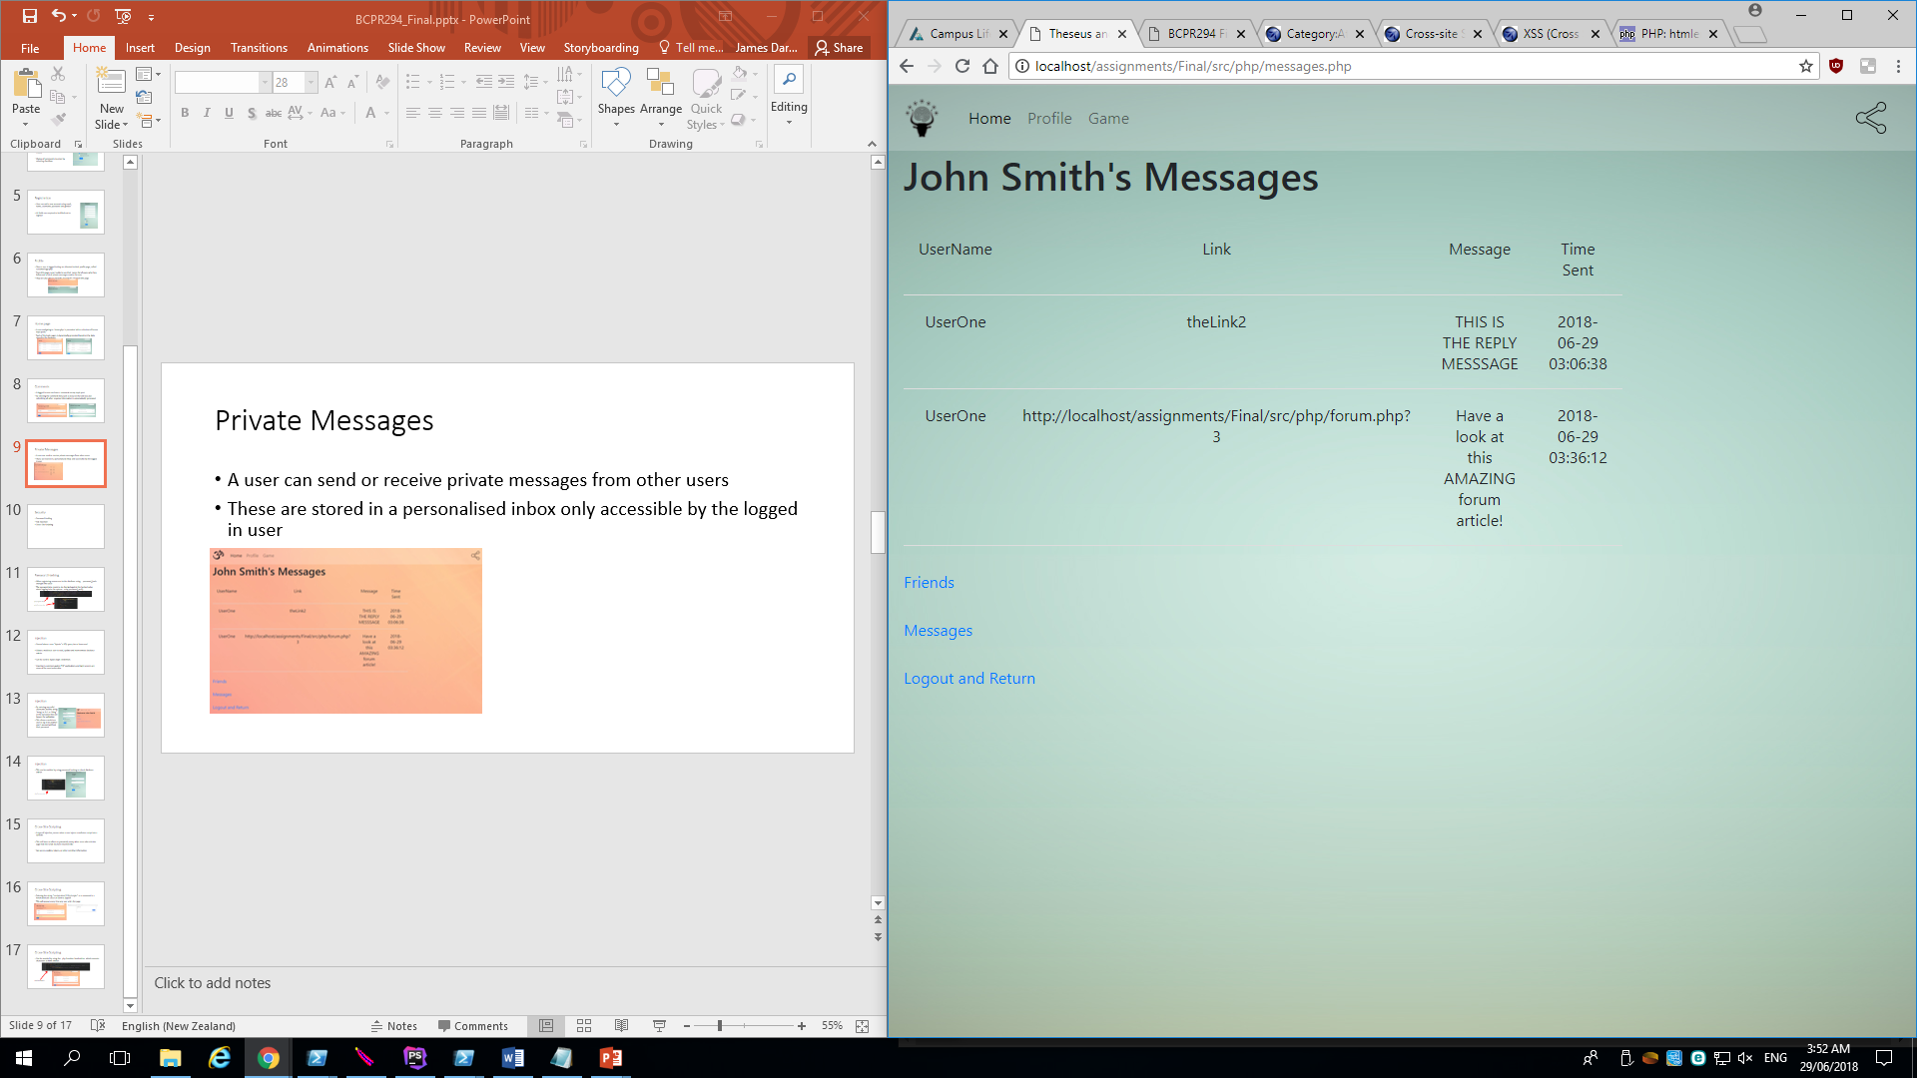
Private Messages
A user can send or receive private messages from other users
These are stored in a personalised inbox only accessible by the logged in user

Slide 10
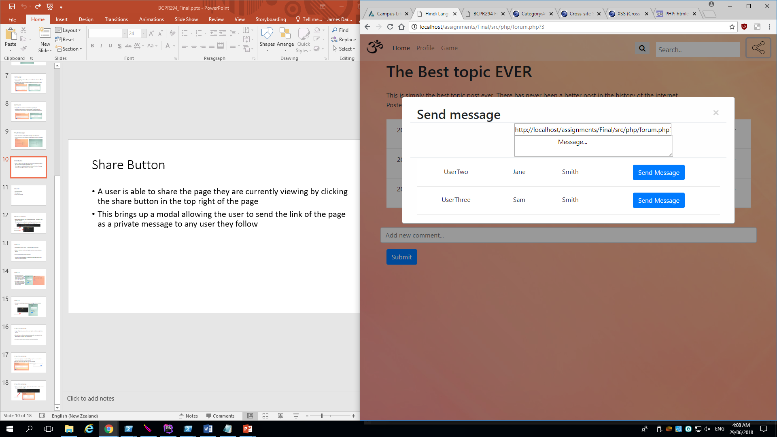
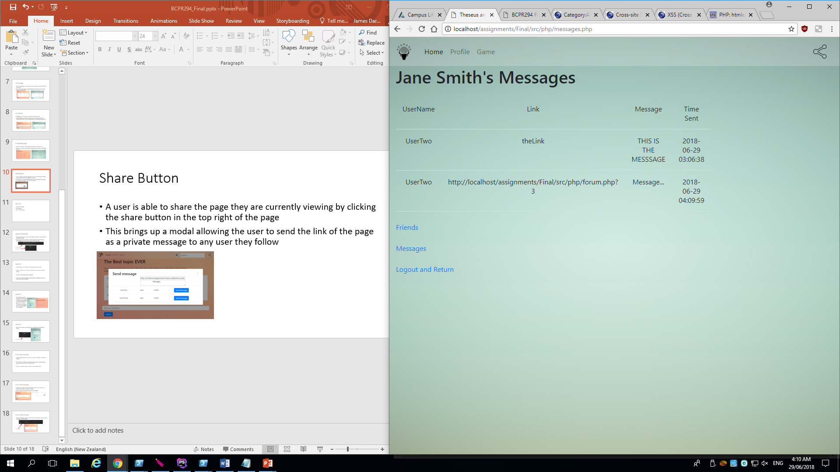
Share Button
A user is able to share the page they are currently viewing by clicking the share button in the top right of the page
This brings up a modal allowing the user to send the link of the page as a private message to any user they follow

Slide 11
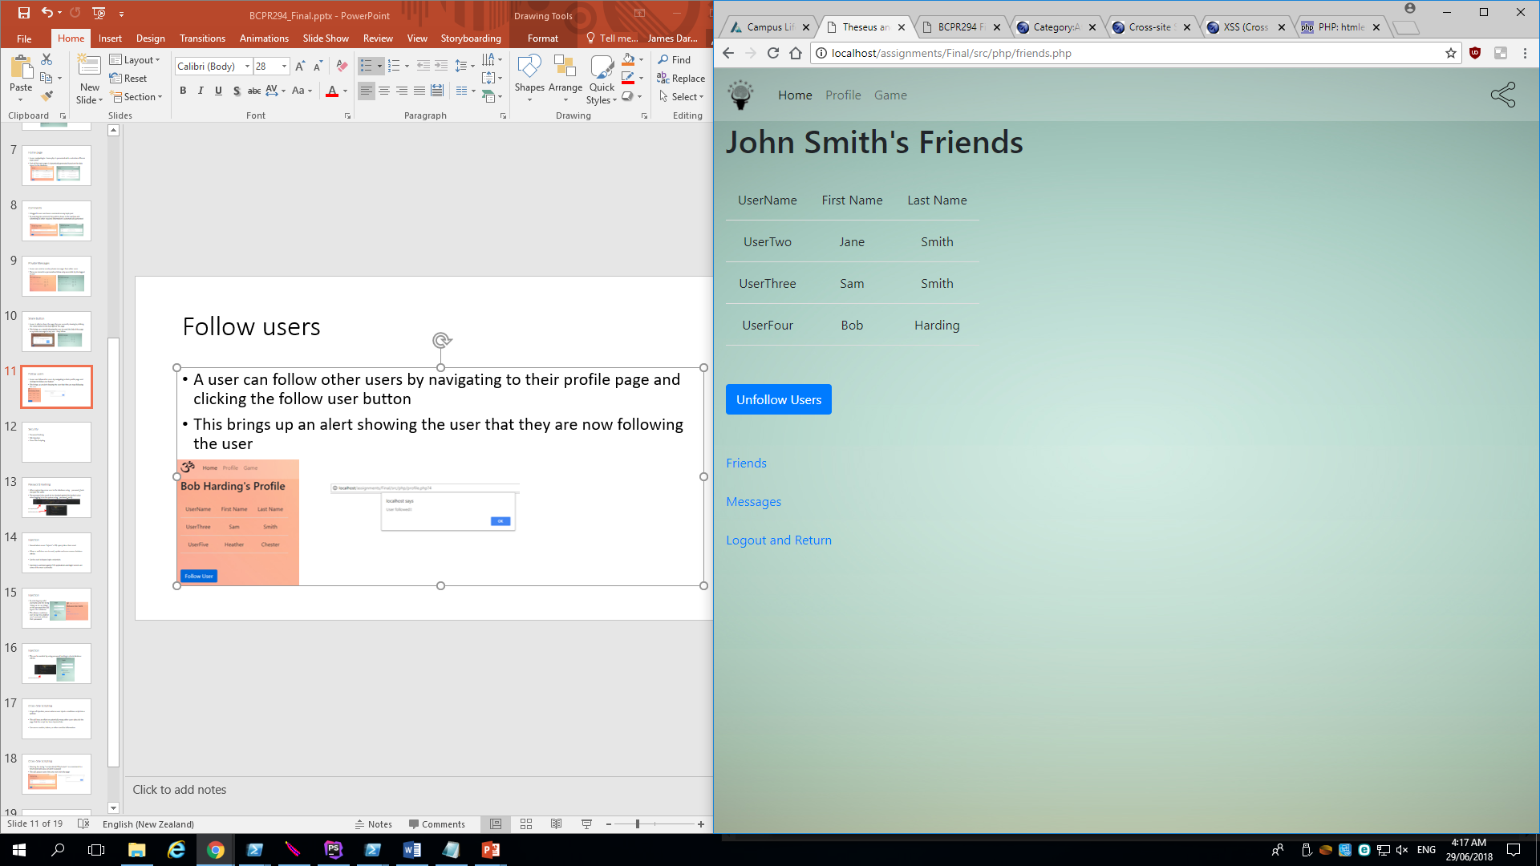
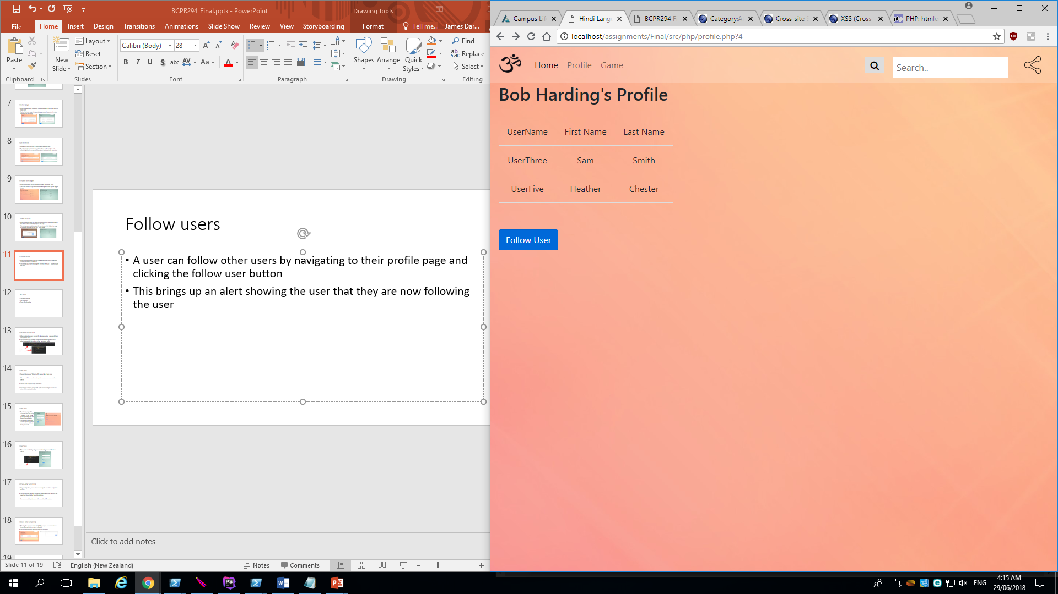
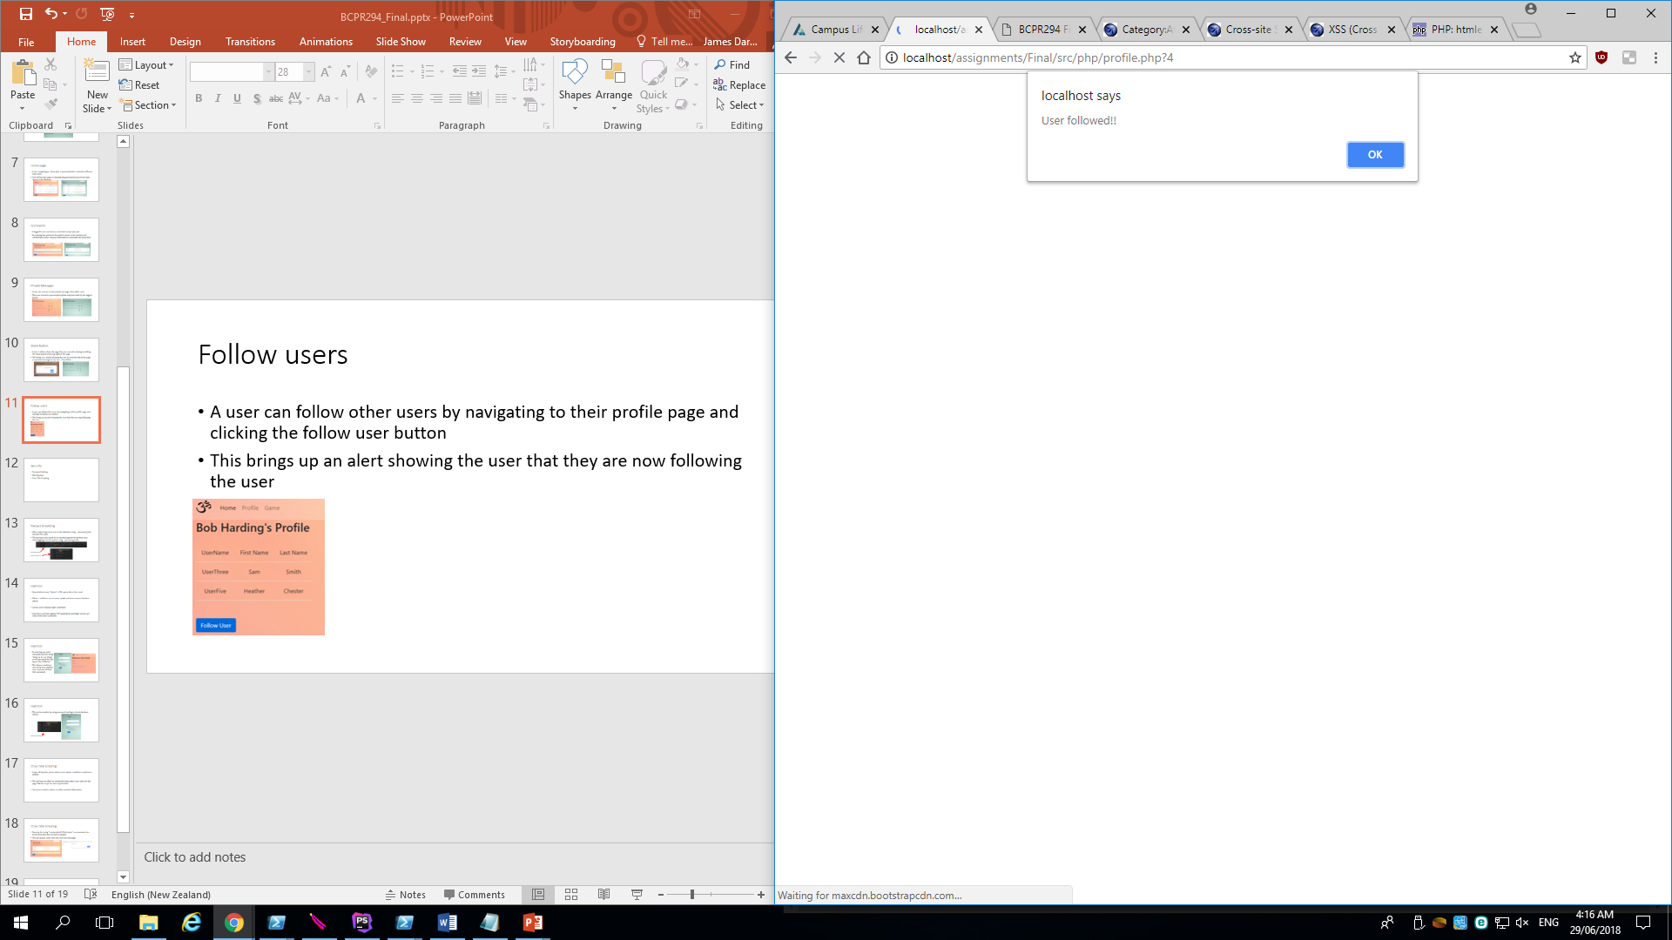
Follow users
A user can follow other users by navigating to their profile page and clicking the follow user button
This brings up an alert showing the user that they are now following the user

Slide 12
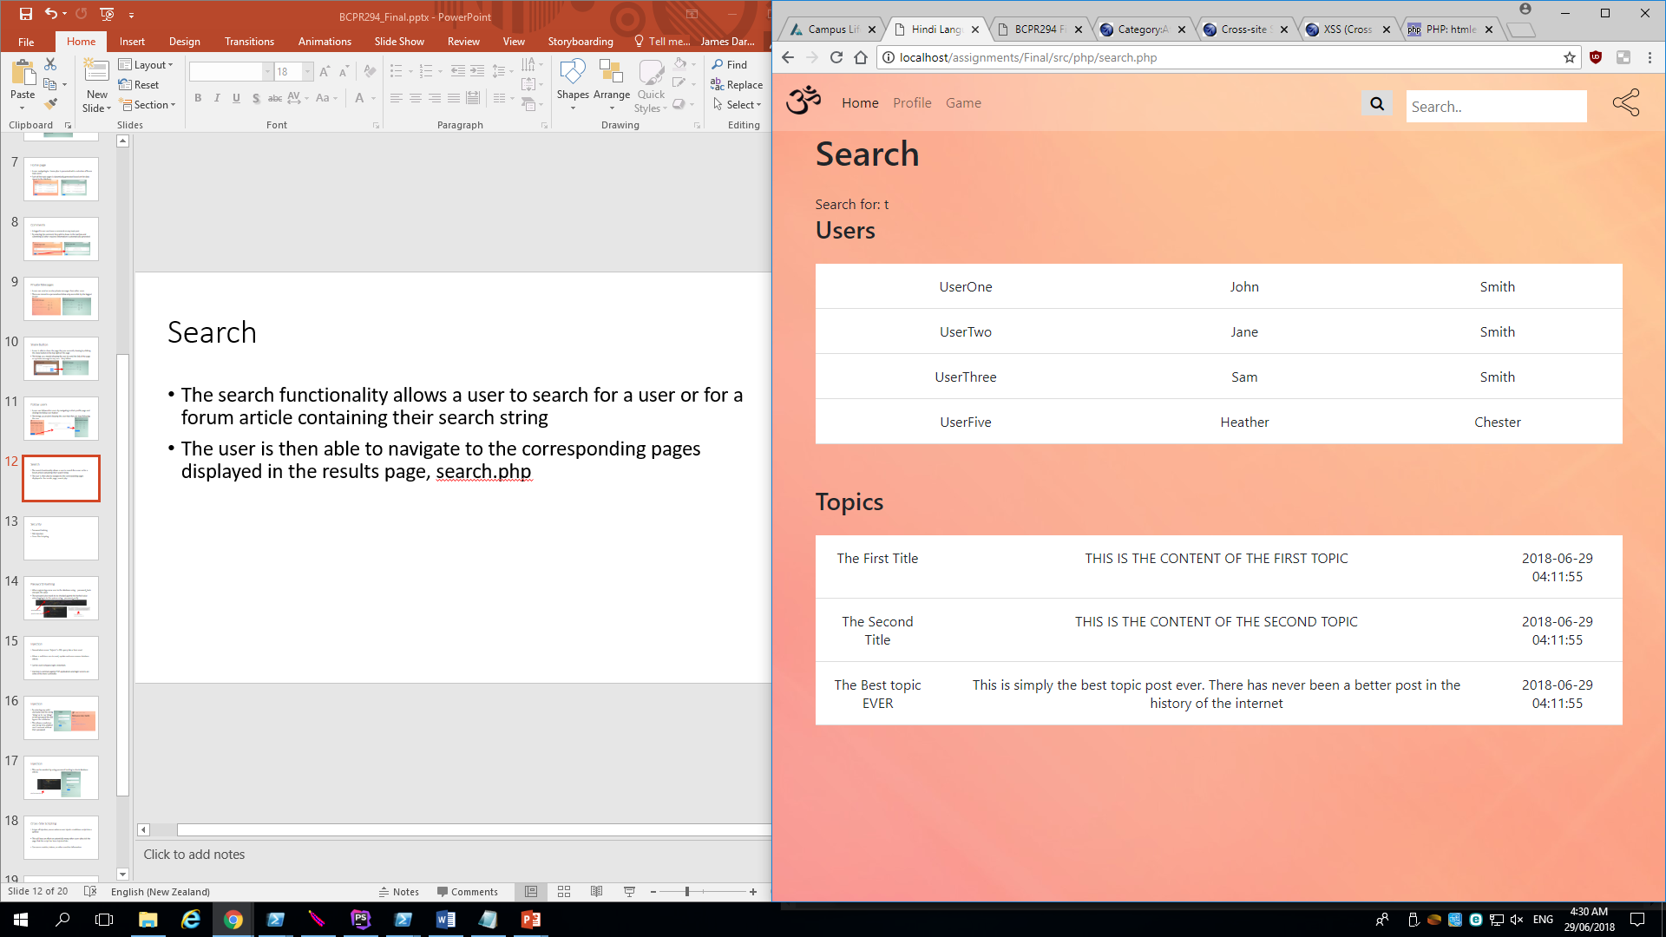
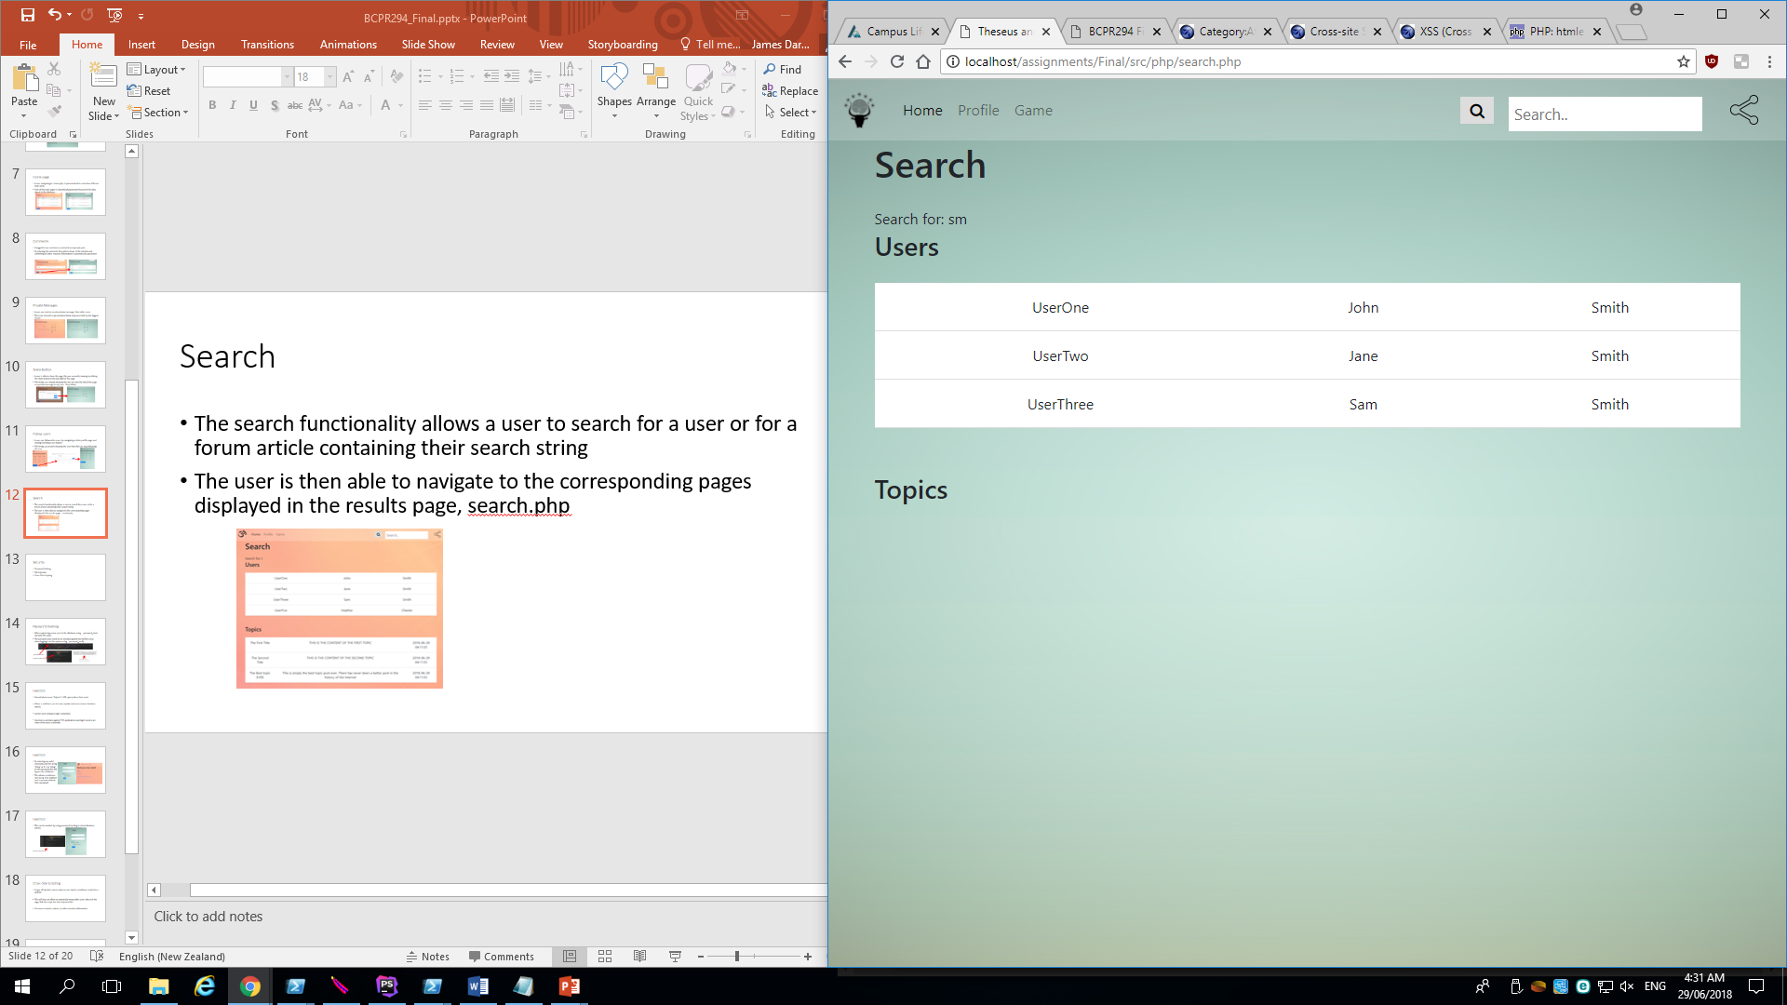
Search
The search functionality allows a user to search for a user or for a forum article containing their search string
The user is then able to navigate to the corresponding pages displayed in the results page, search.php

Slide 13
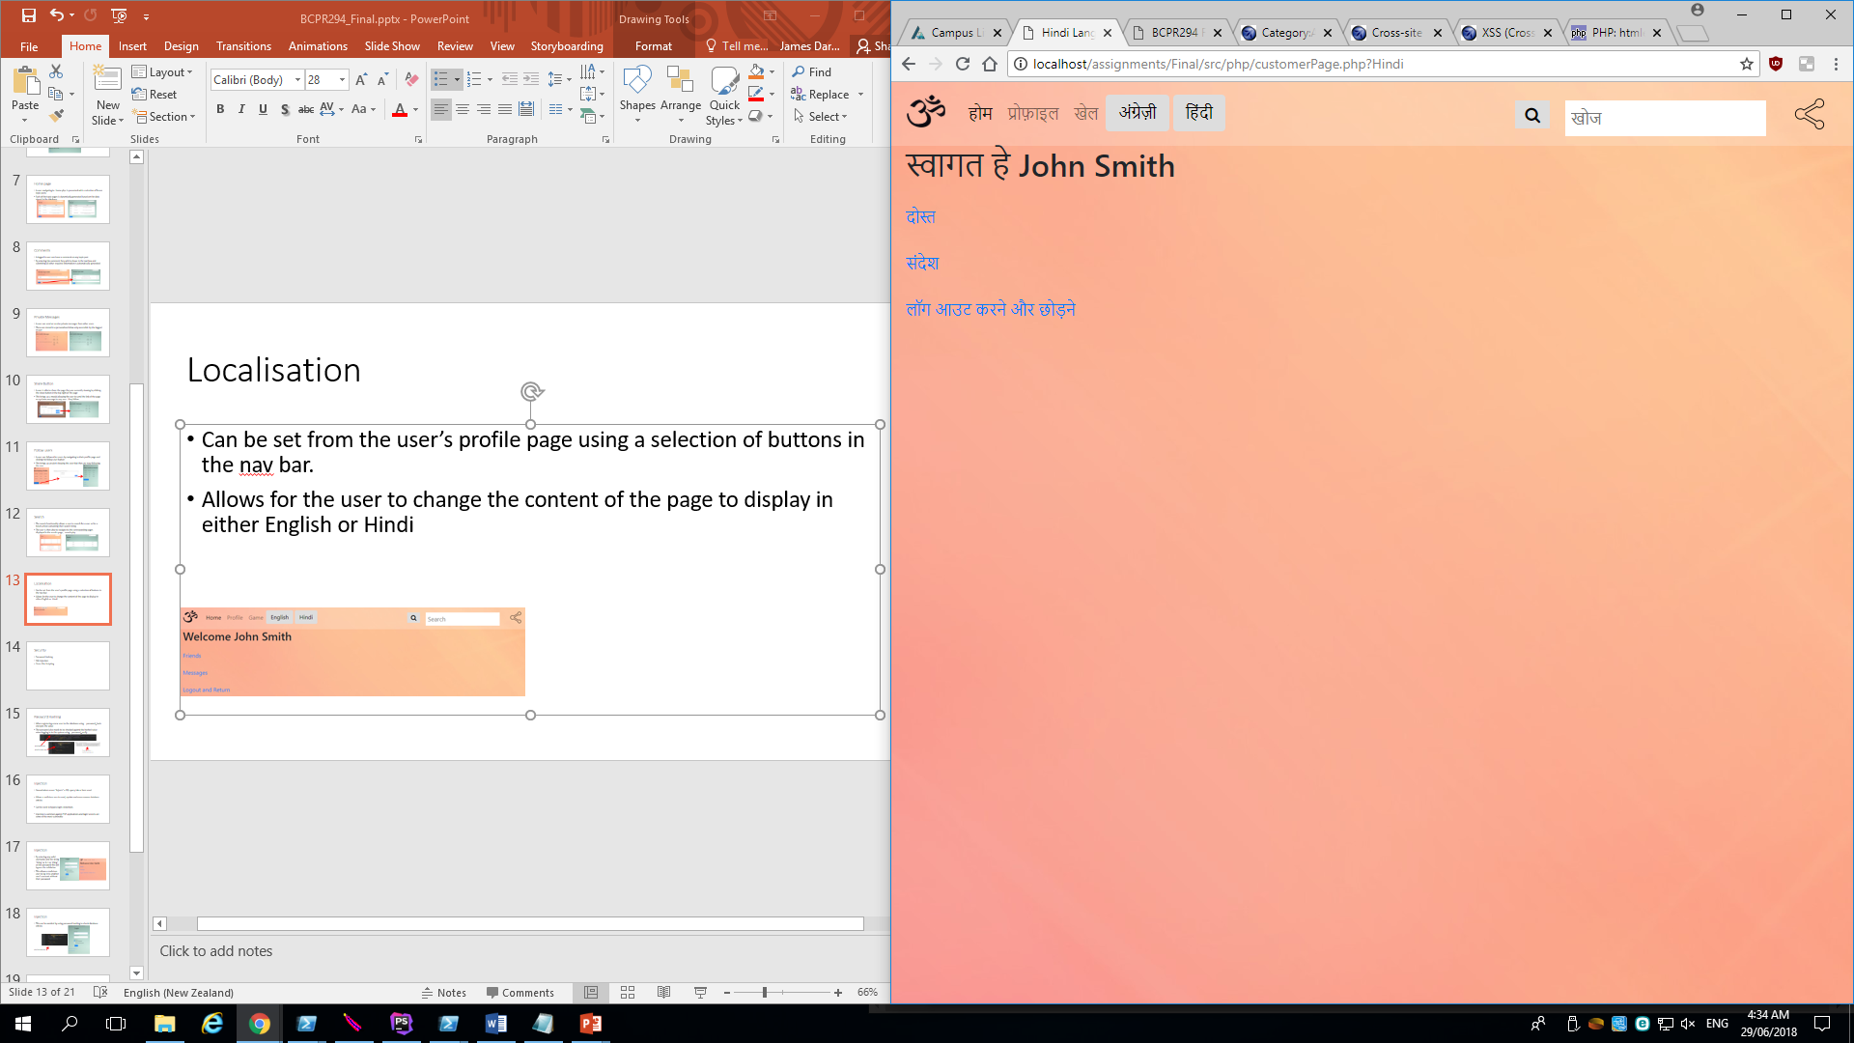
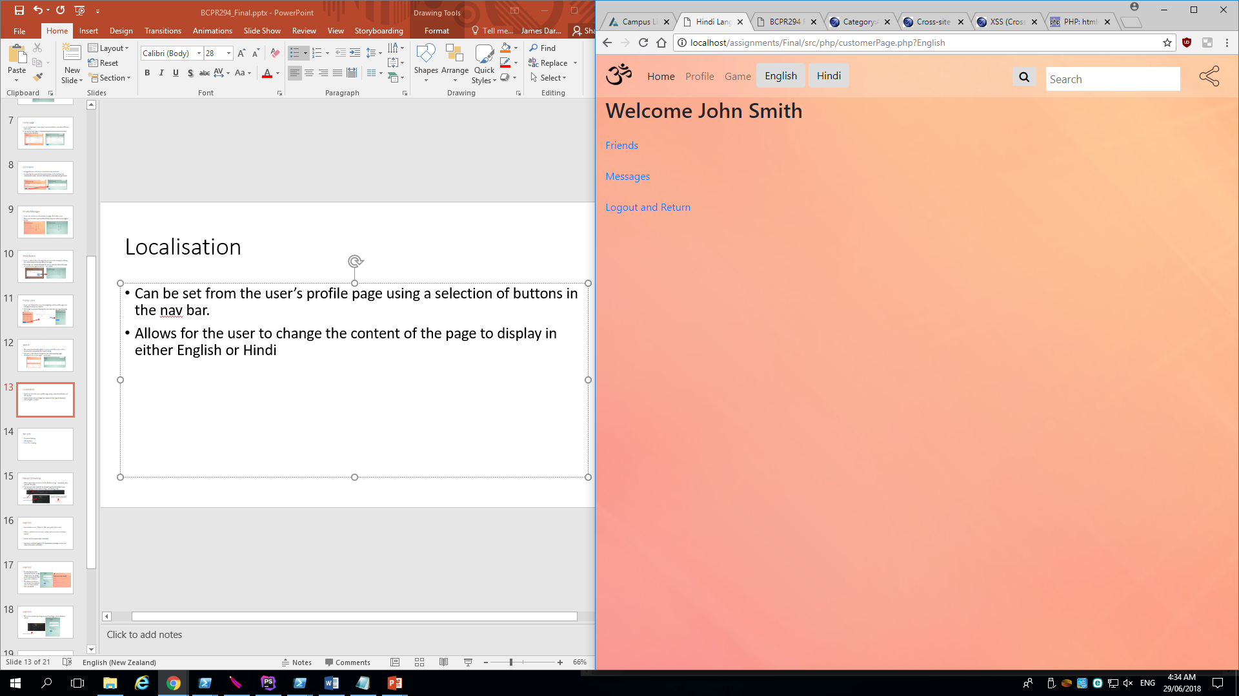
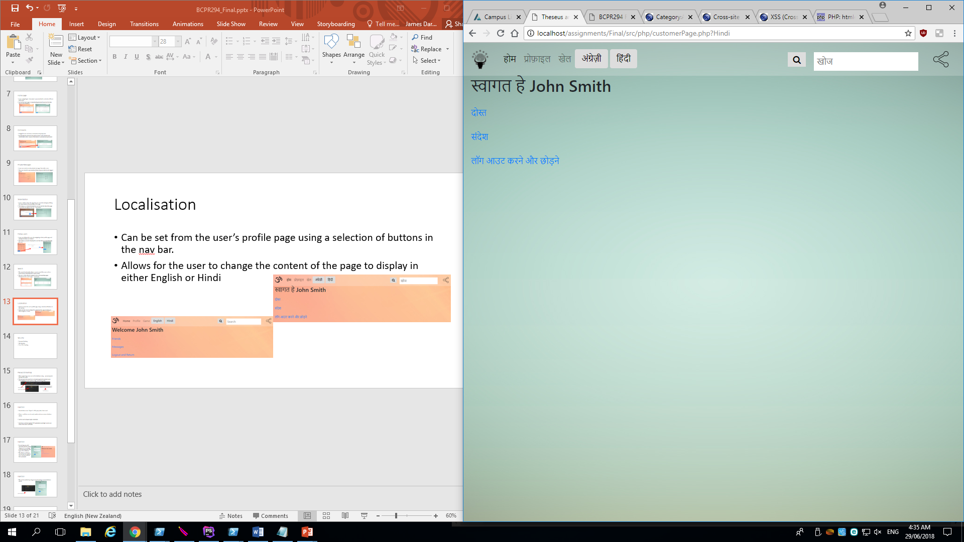
Localisation
Can be set from the user’s profile page using a selection of buttons in the navigation bar
Allows for the user to change the content of the page to display in either English or Hindi

Slide 14
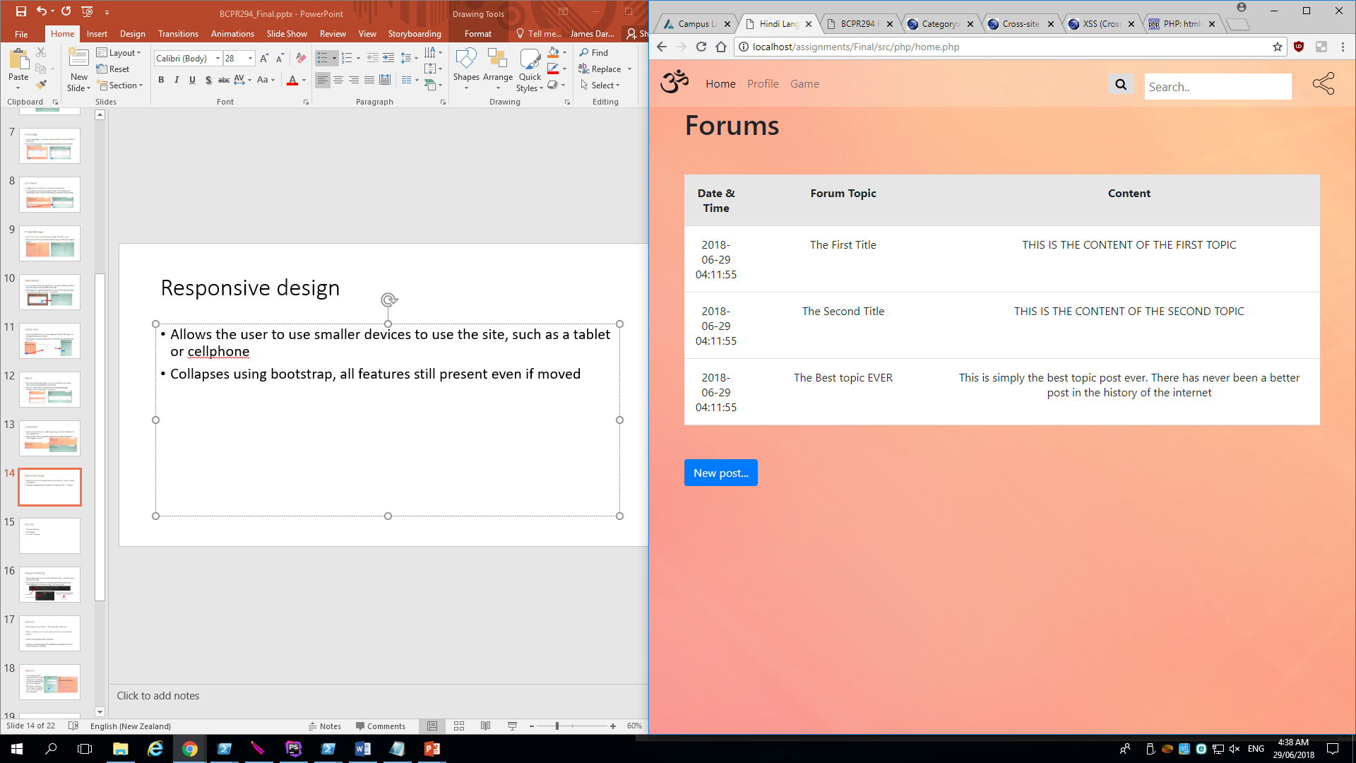
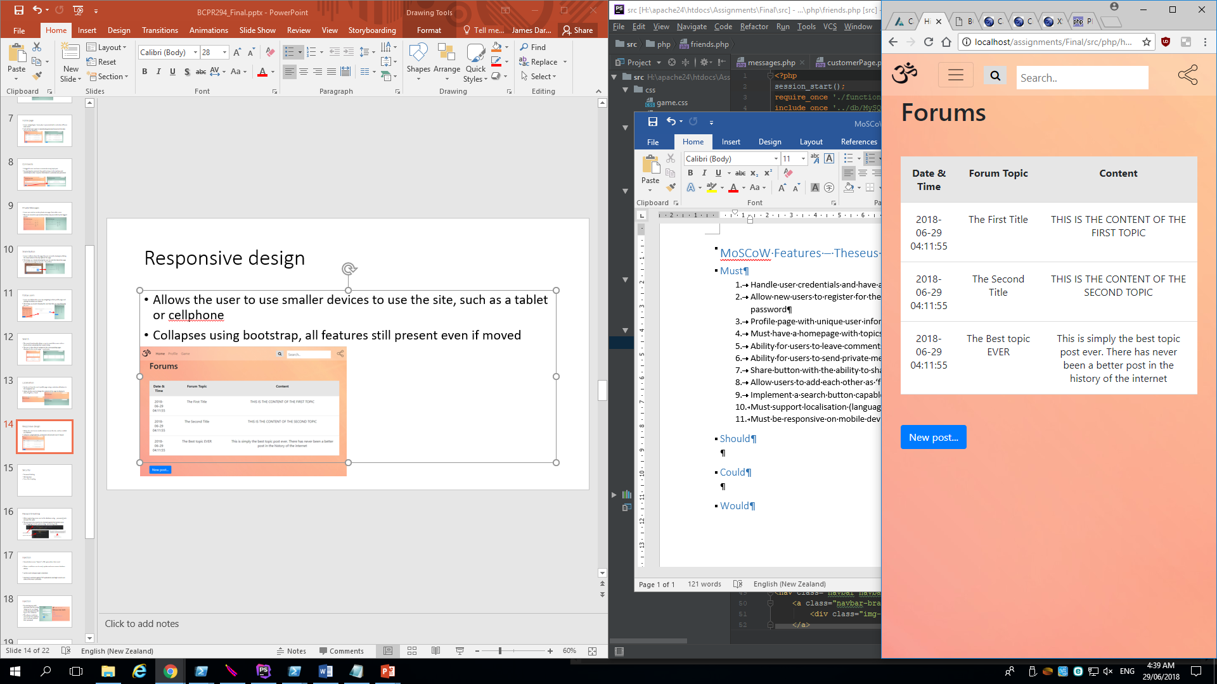
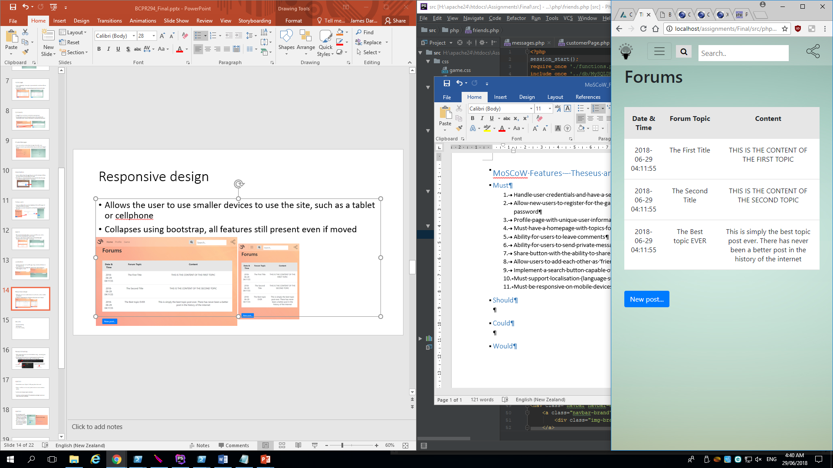
Responsive design
Allows the user to use smaller devices to use the site, such as a tablet or cellphone
Collapses using bootstrap, all features still present even if moved

Slide 15
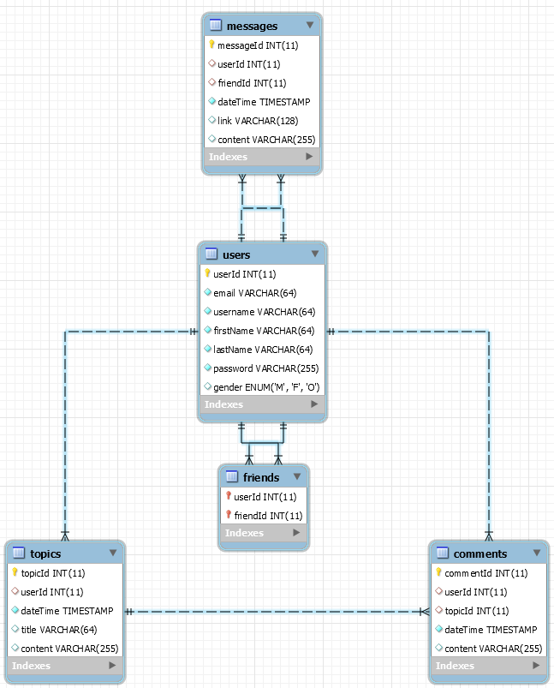
Database - Diagram

Slide 16
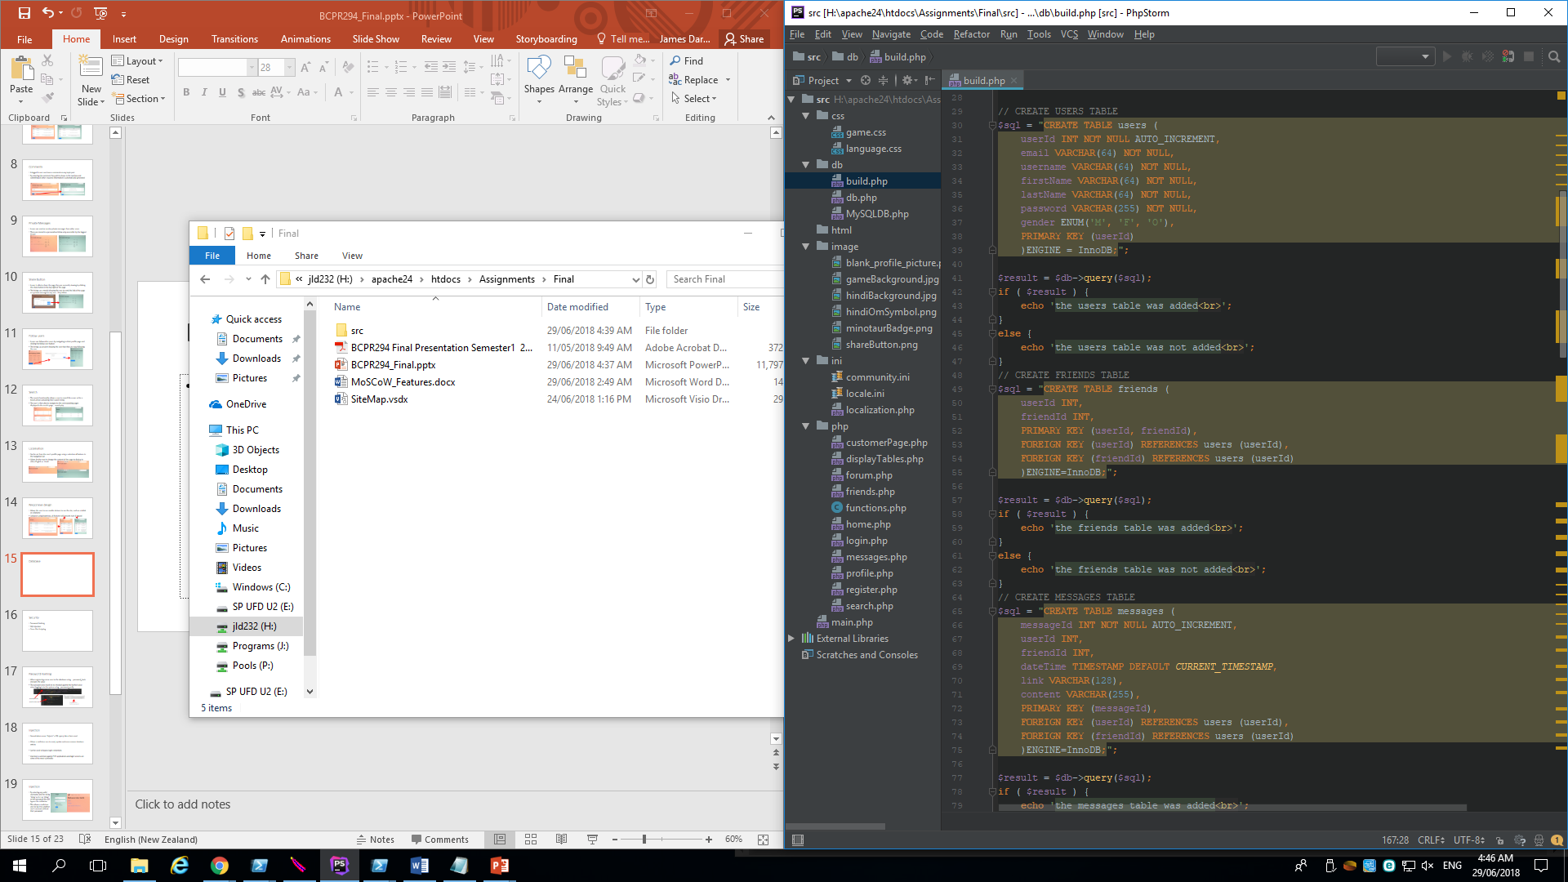
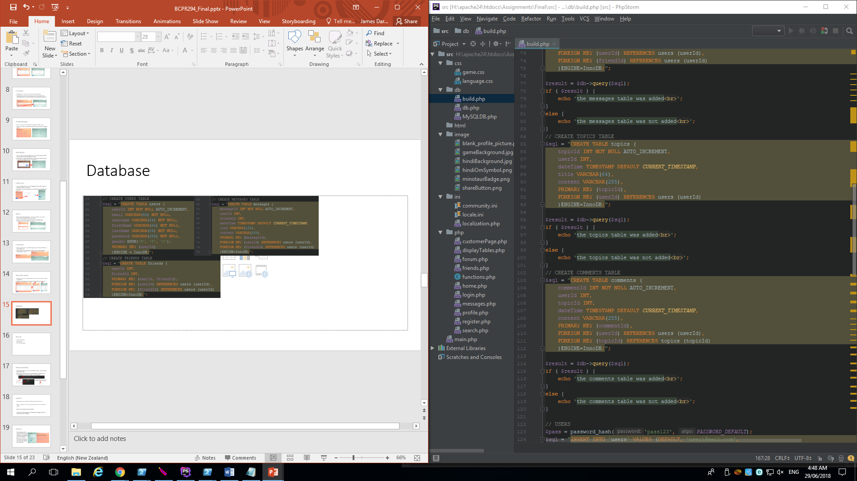
Database – Create tables
Tables are initially created and sample data is provided

Slide 17
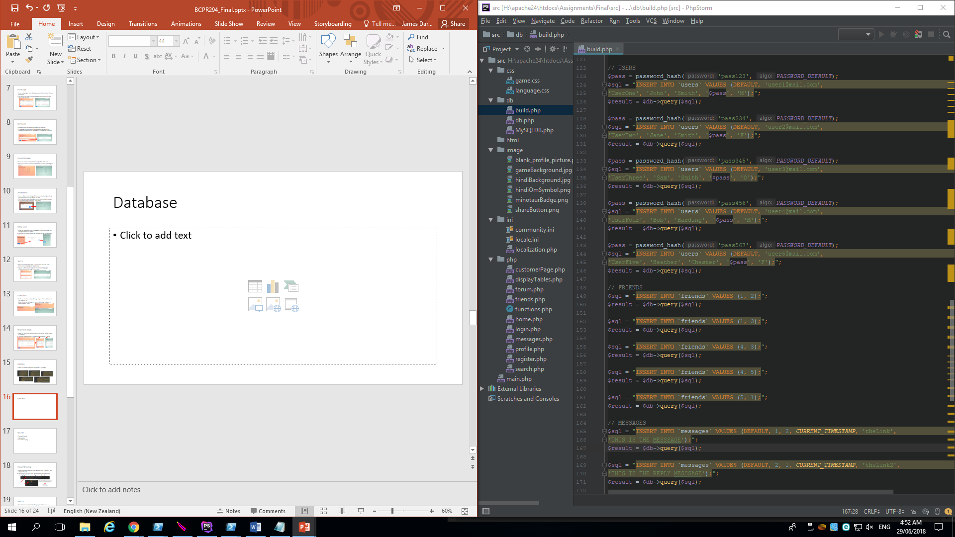
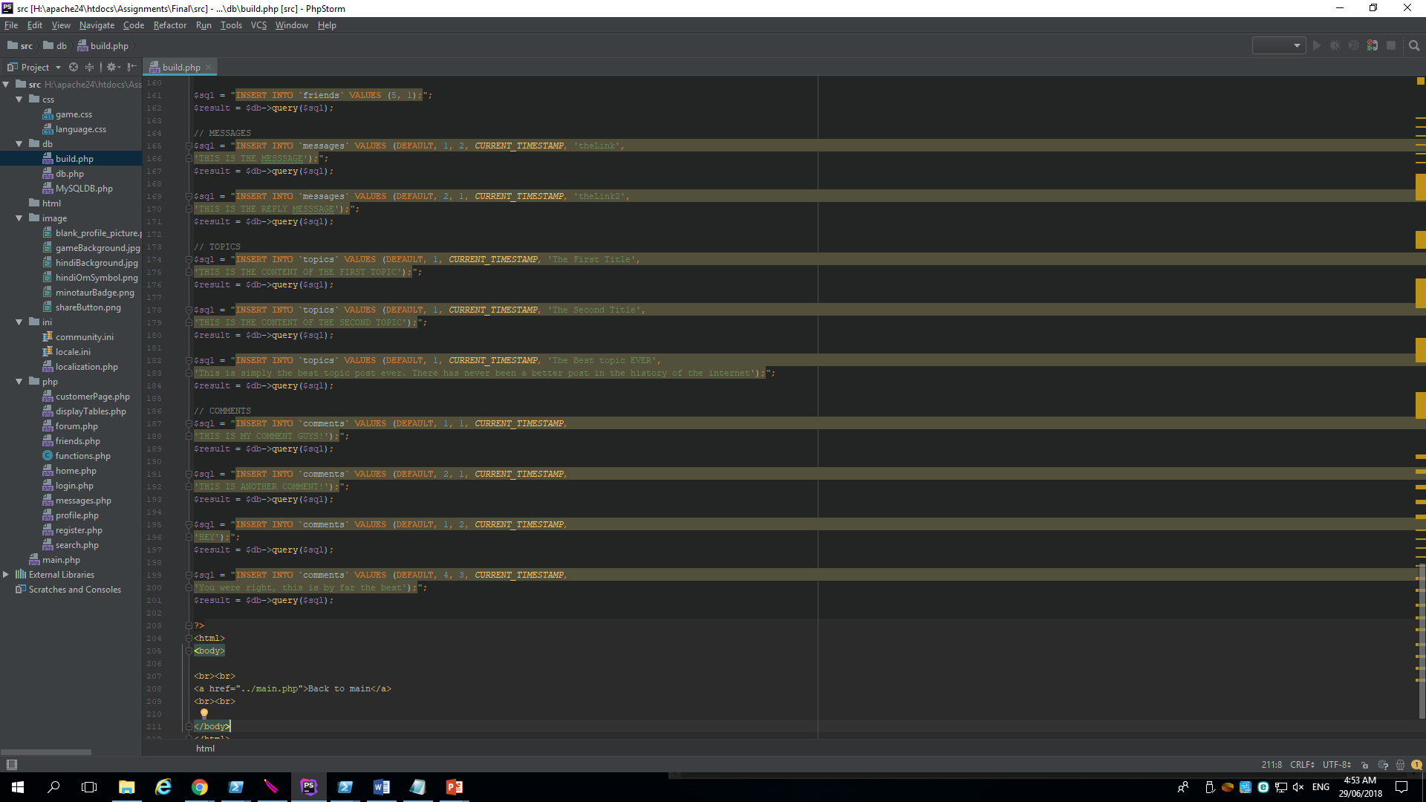
Database – Insert sample data

Slide 18
Database – Insert new data
New entries can be added to the `users` table using register.php
New entries can be added to the `friends` table using the ‘follow user’ button on the selected user’s profile page
New entries can be added to the `comments` table using the ‘submit’ button on the related forum.php
New entries can be added to the `messages` table using the ‘share’ button in the nav bar and selecting a user to send the message to

Slide 19
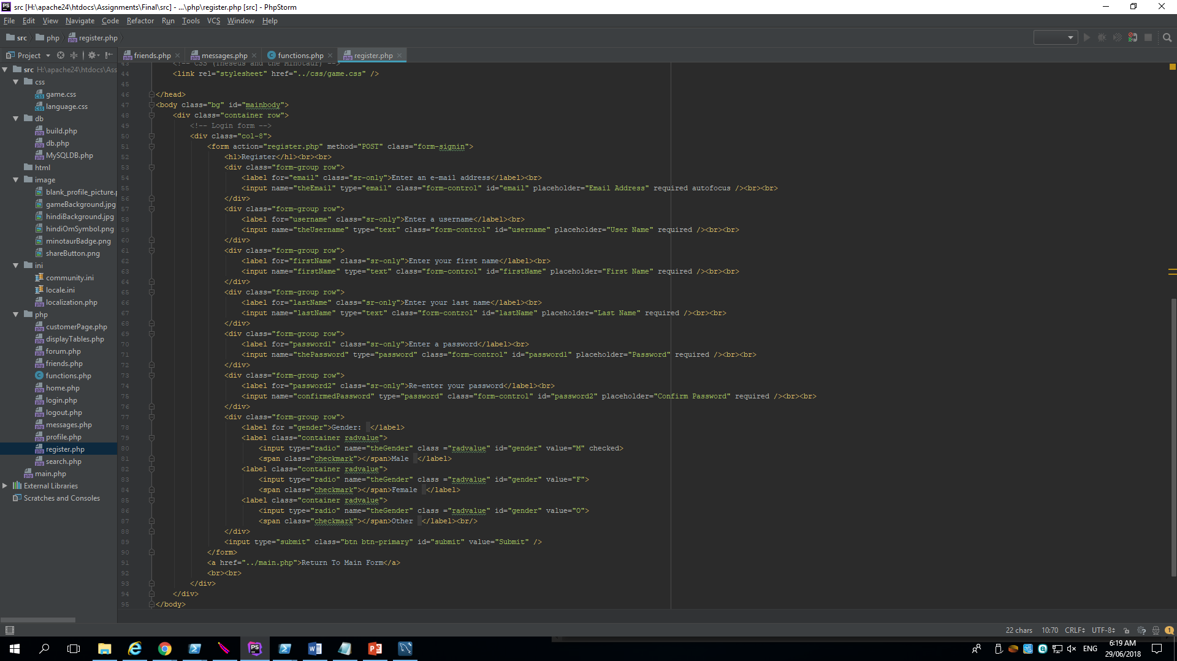
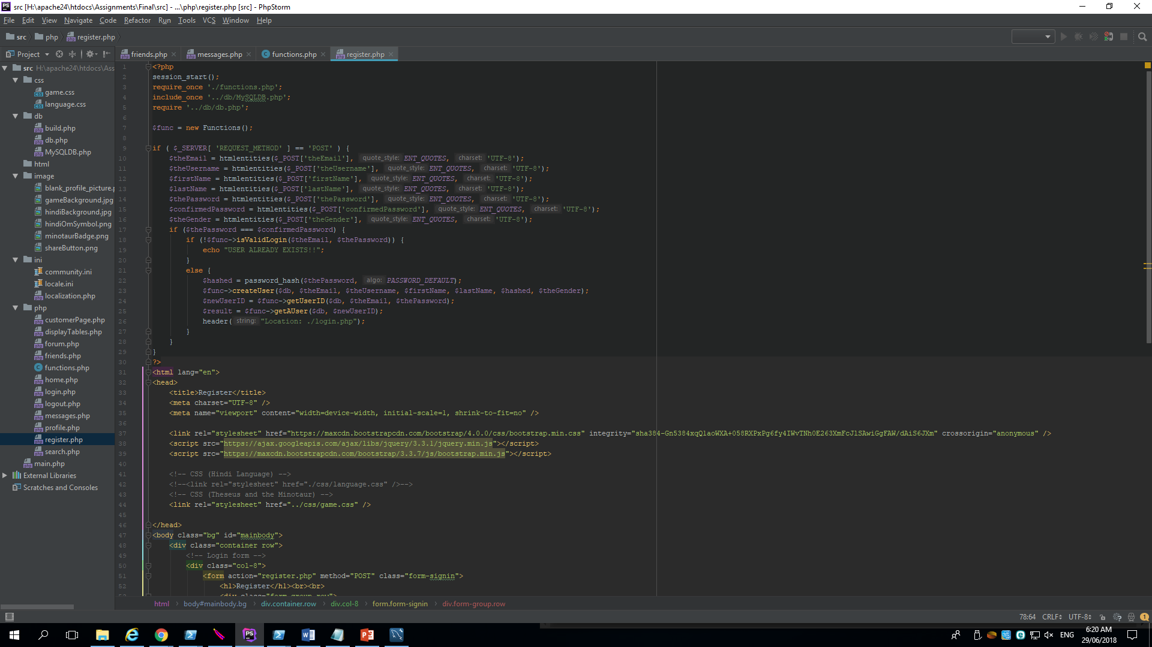
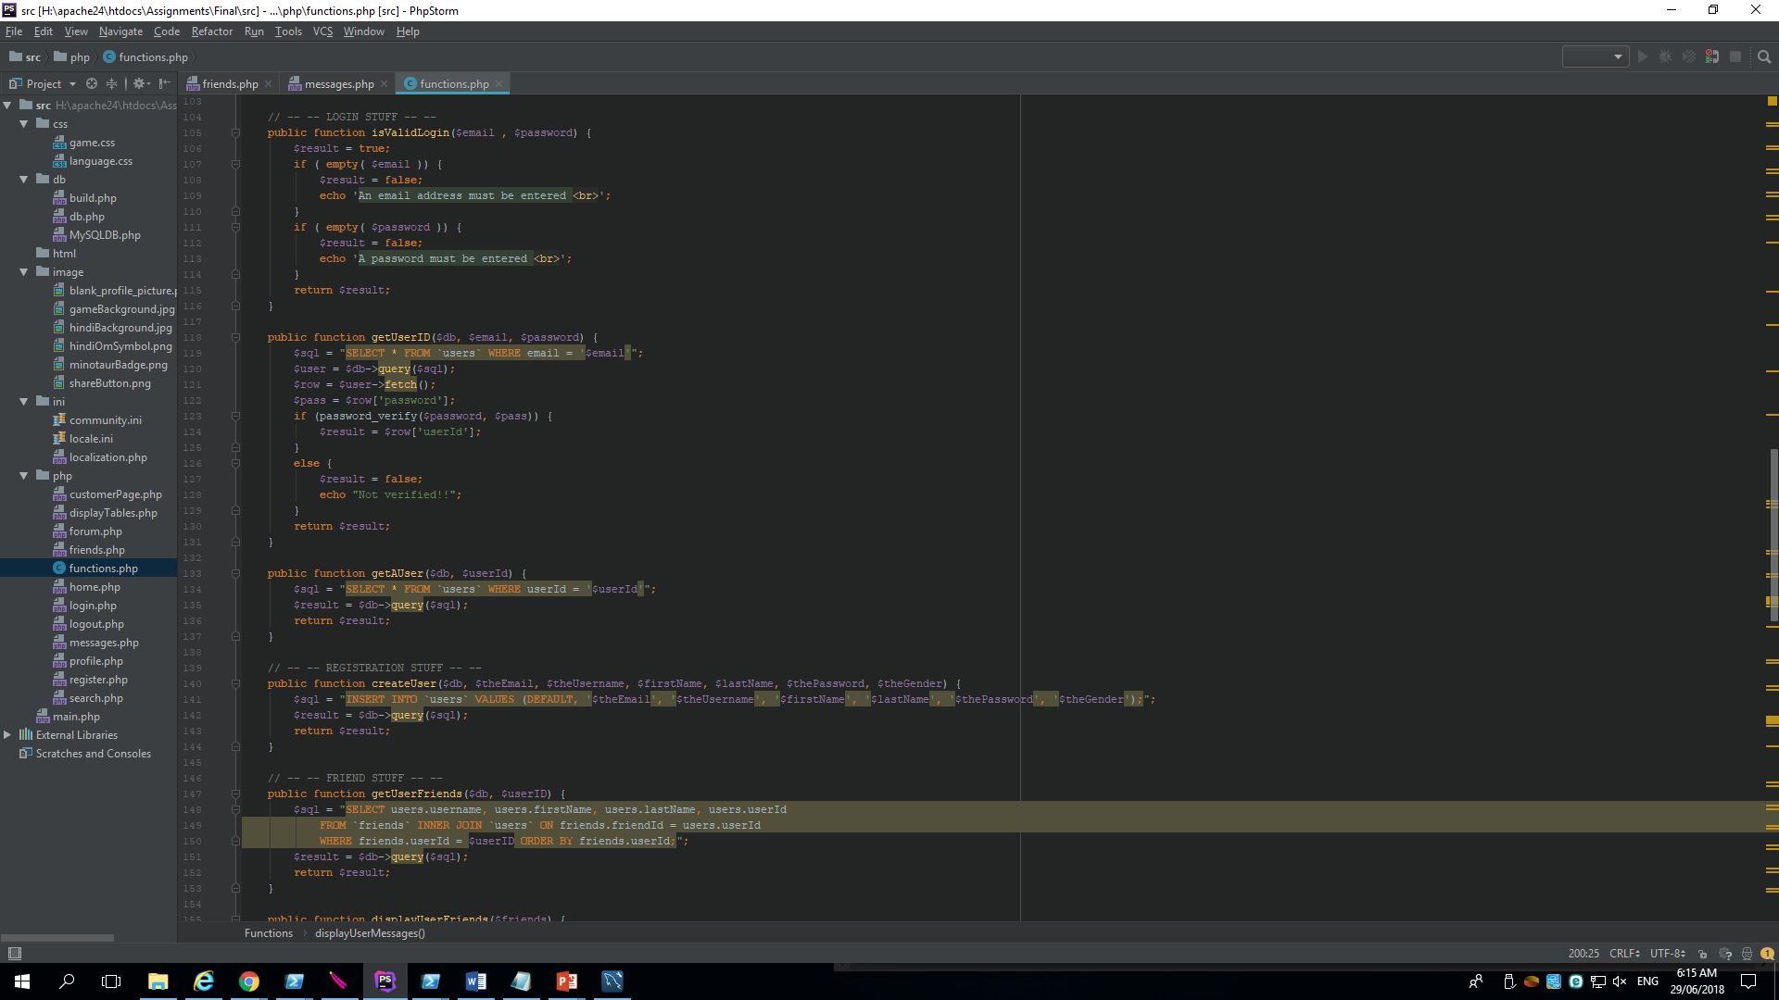
Database – Insert new users
php/register.php php/functions.php

Slide 20
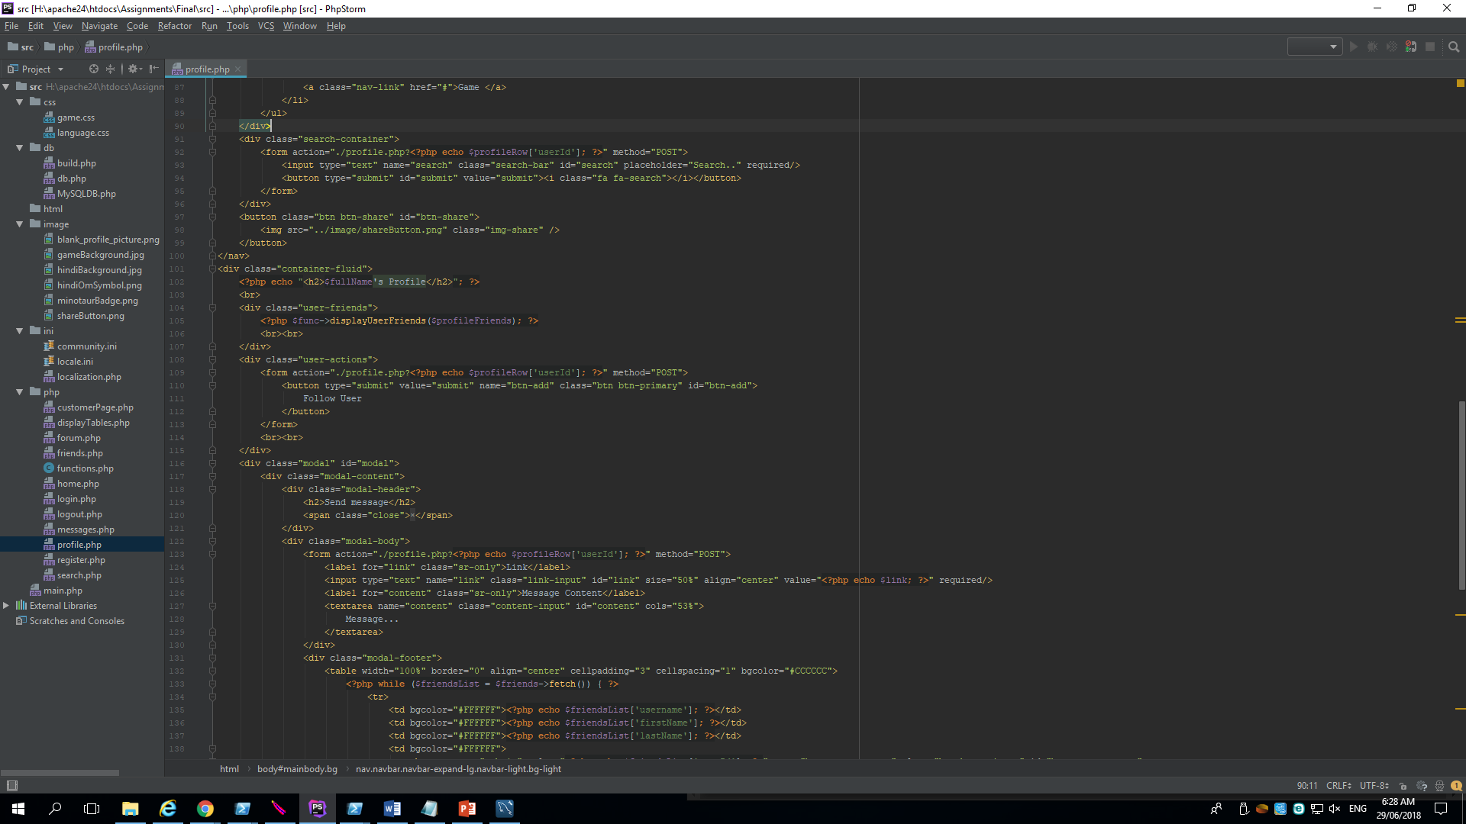
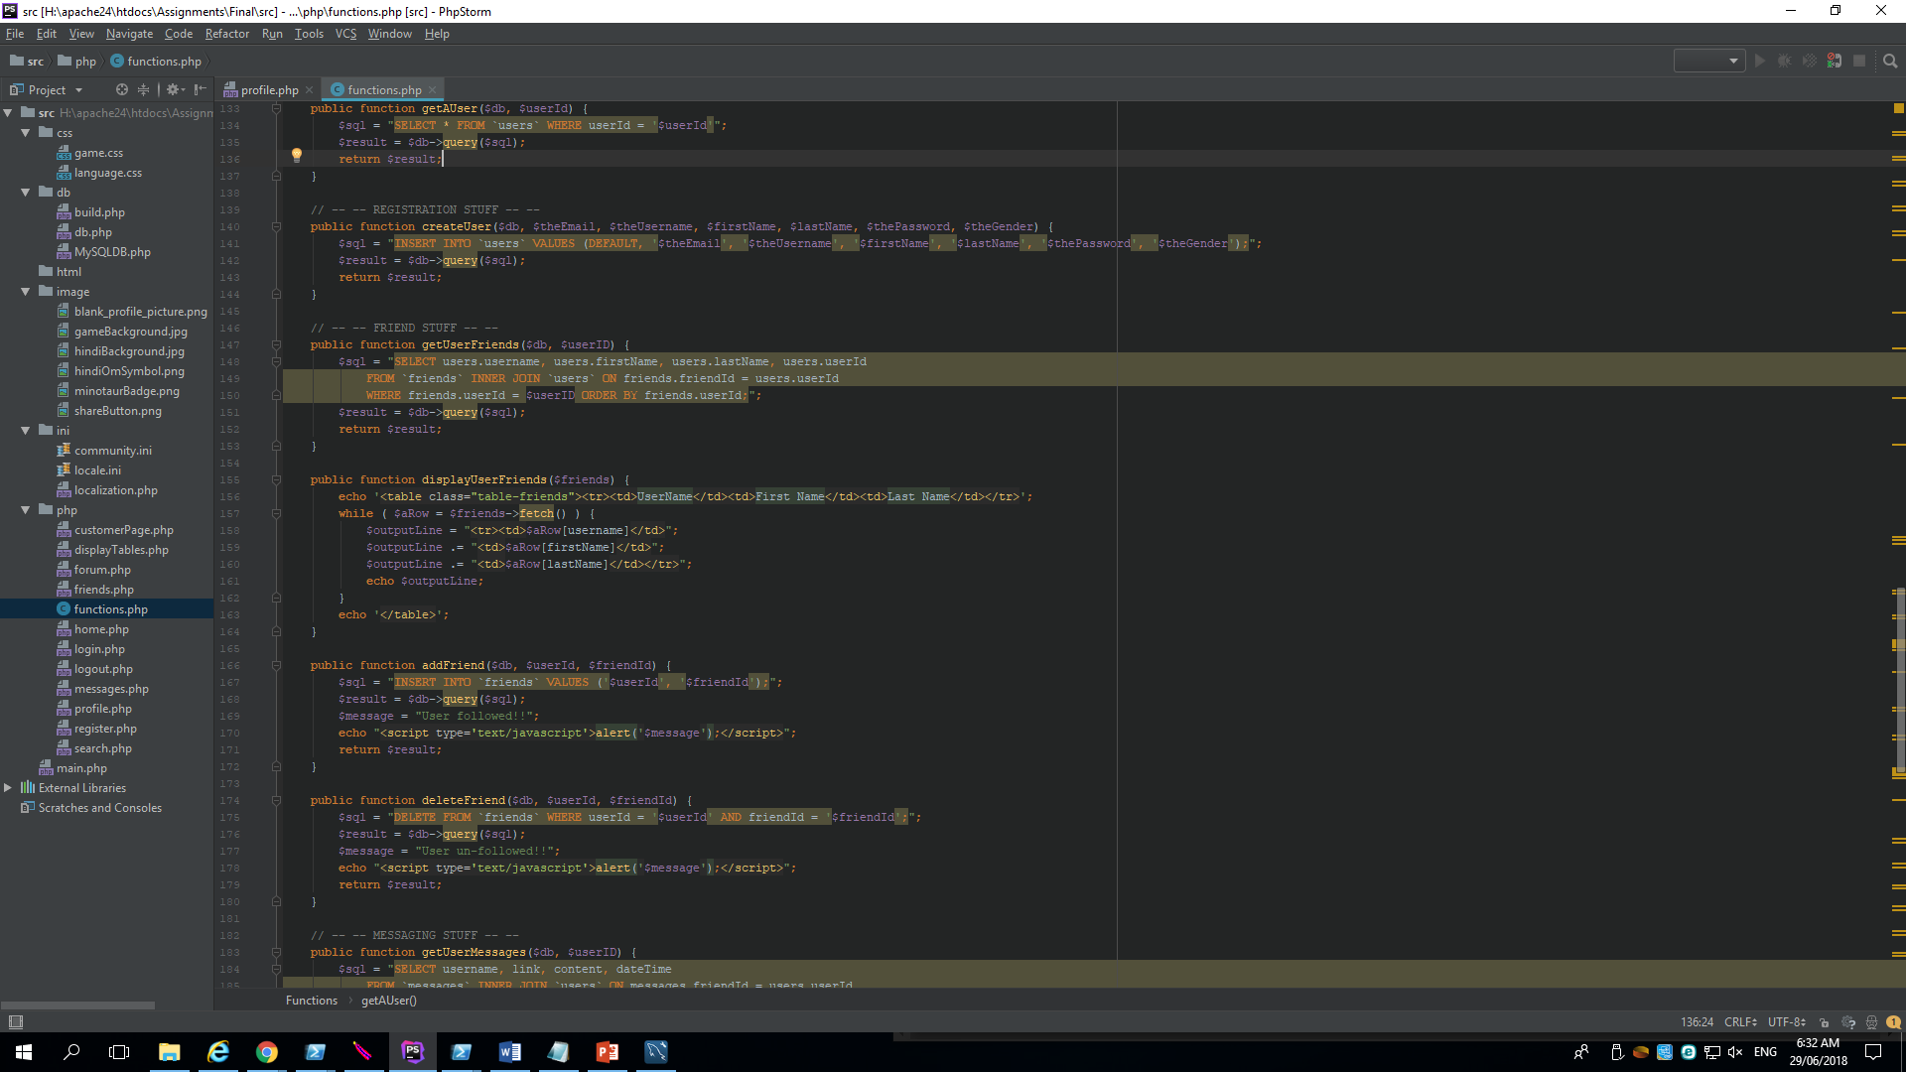
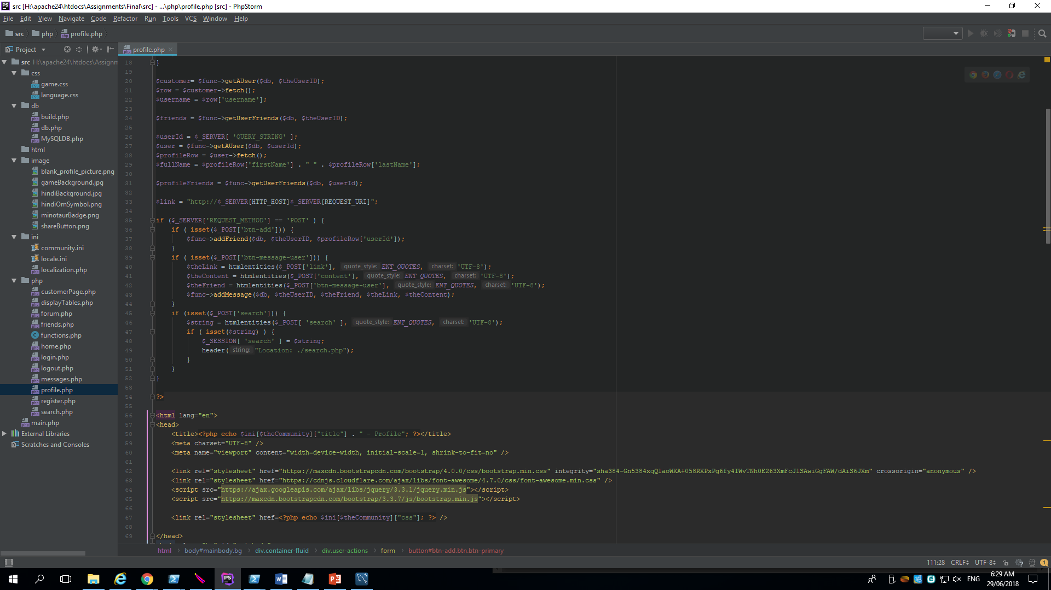
Database – Insert new friends
php/profile.php
php/functions.php

Slide 21
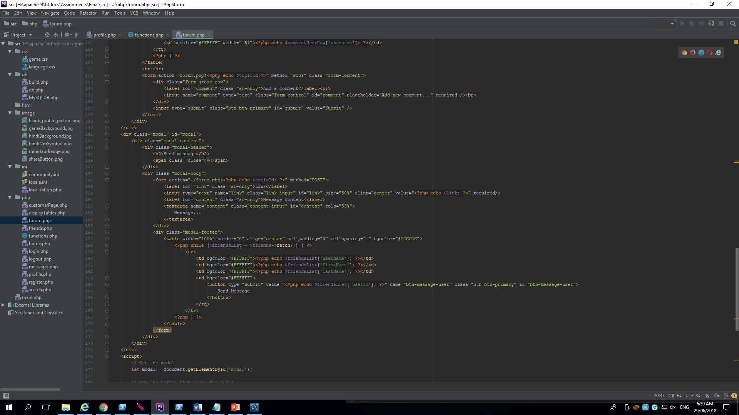
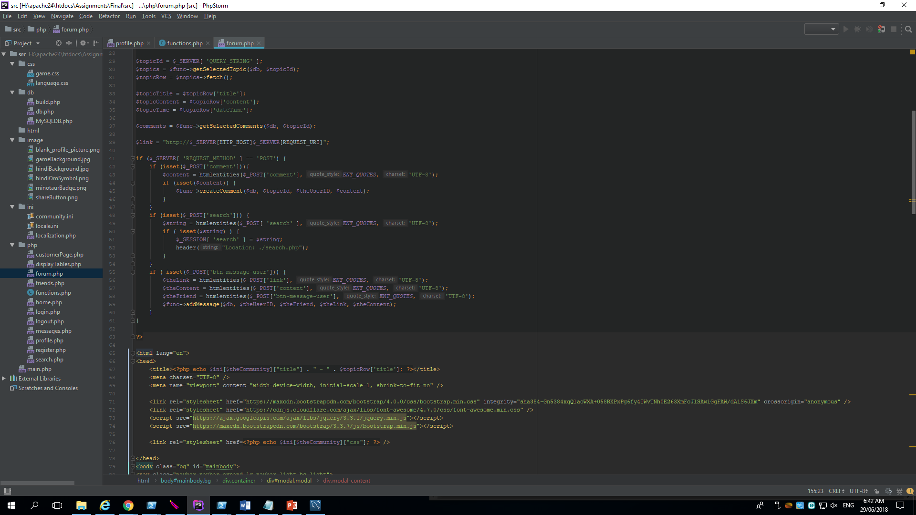
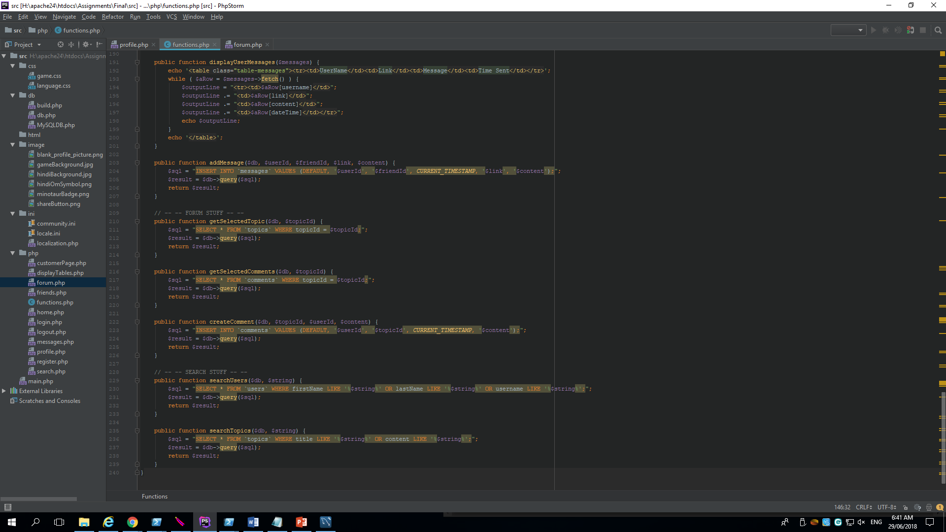
Database – Insert new comment
php/forum.php
php/functions.php

Slide 22
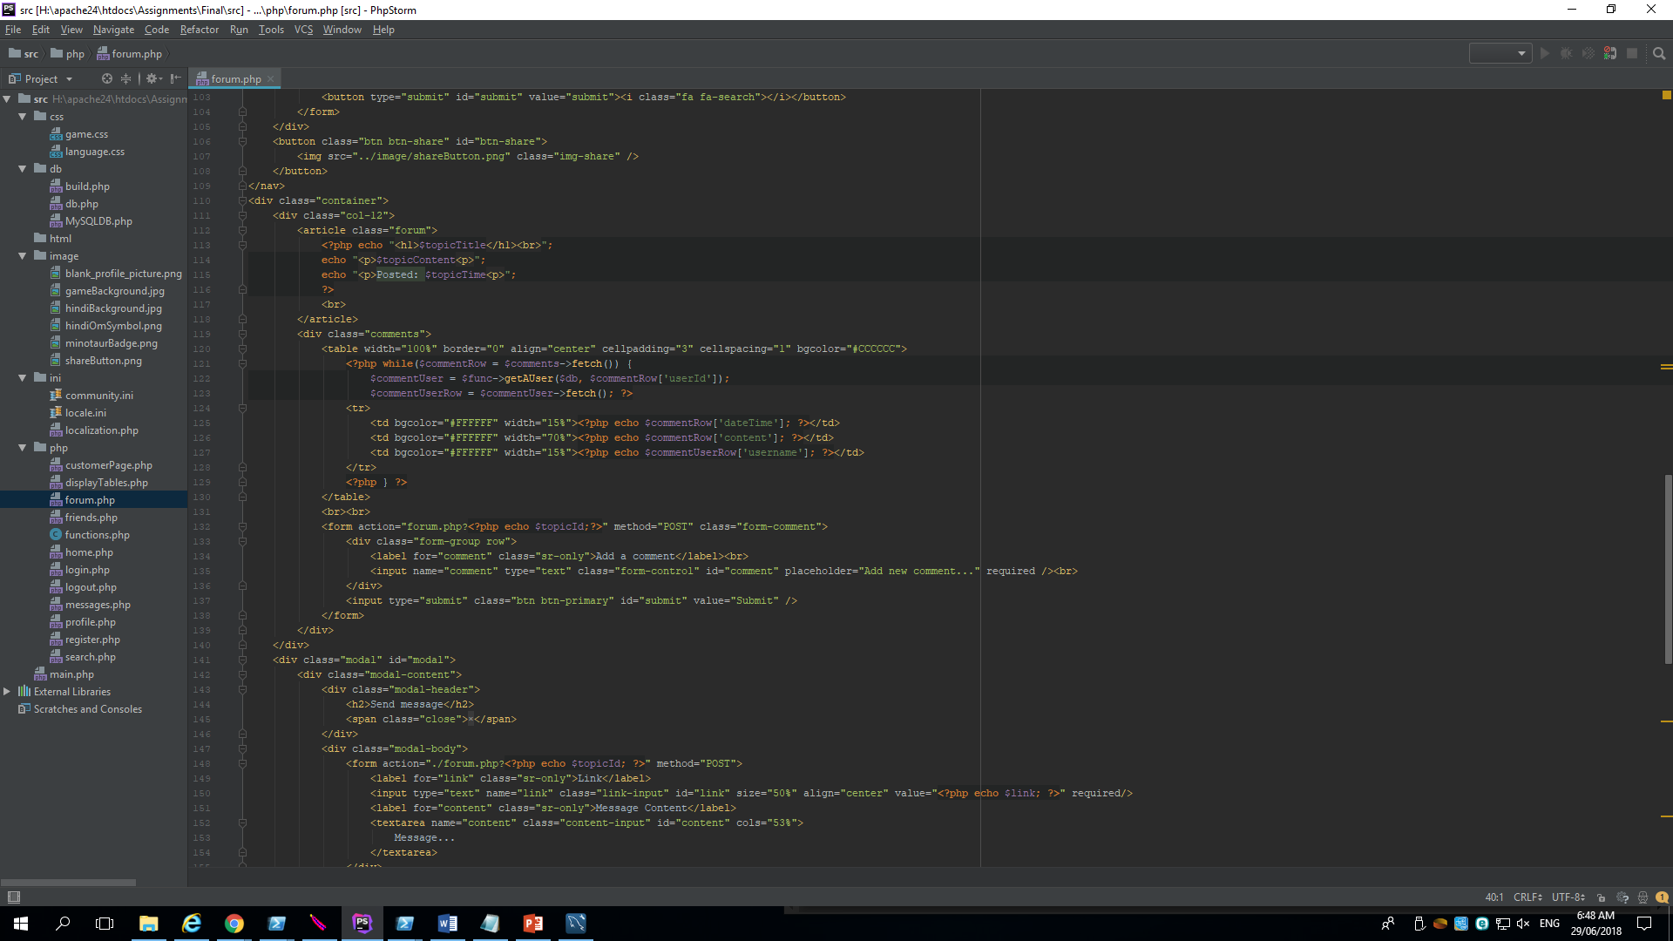
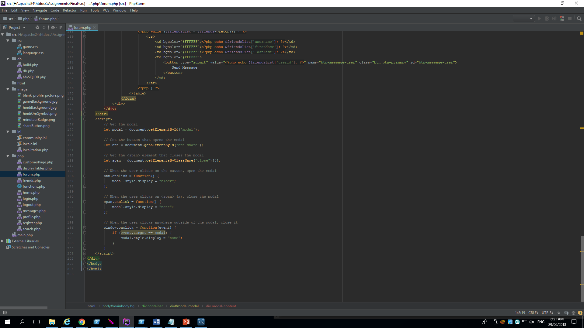
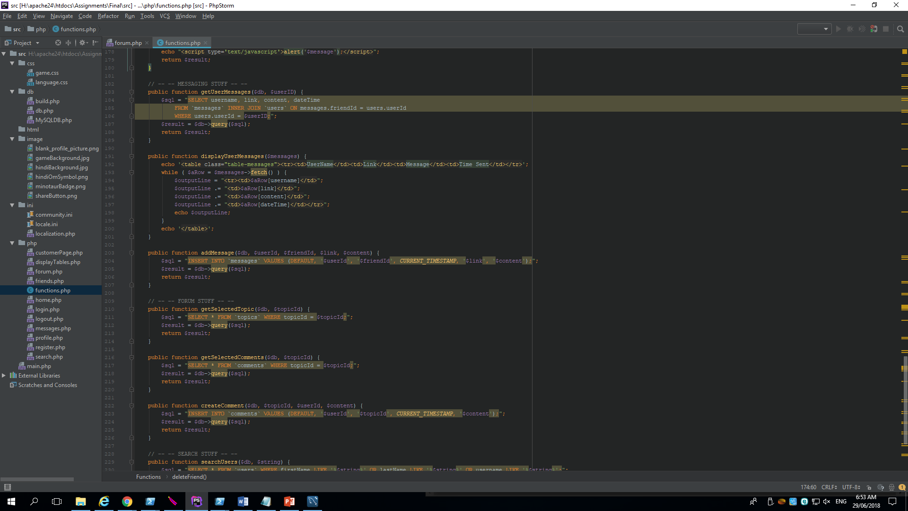
Database – Insert new messages
php/forum.php
php/functions.php

Slide 23
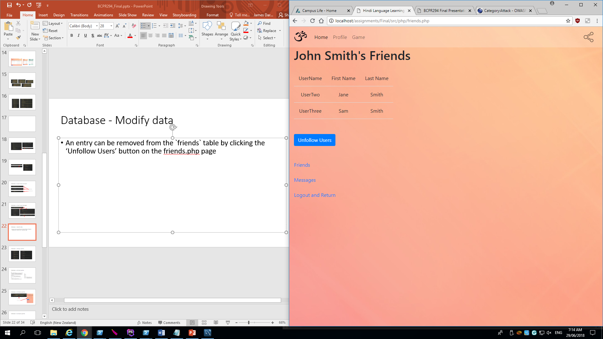
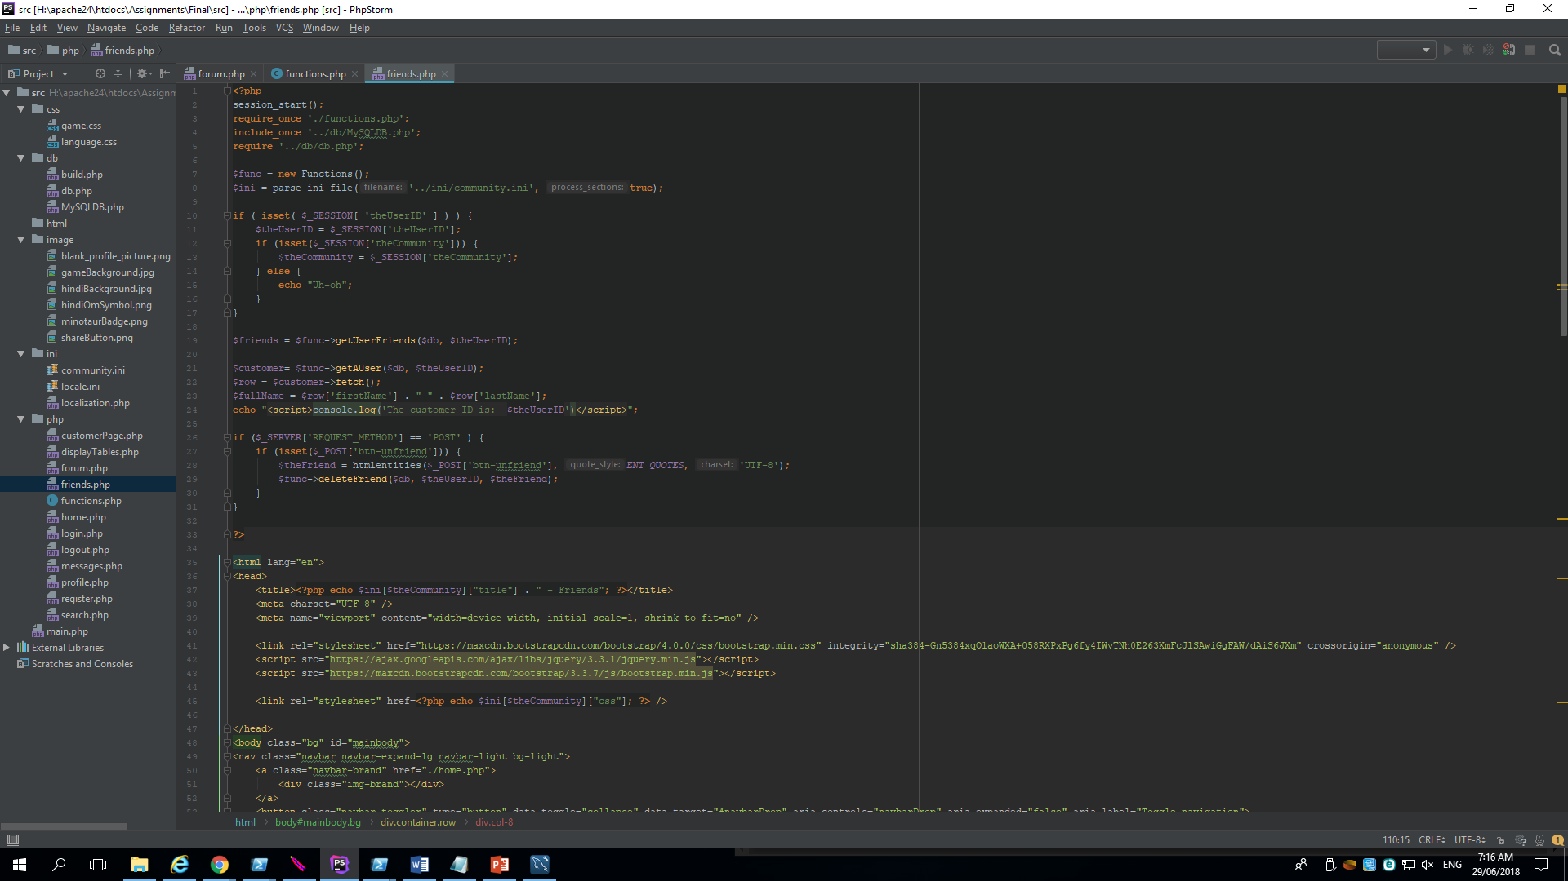
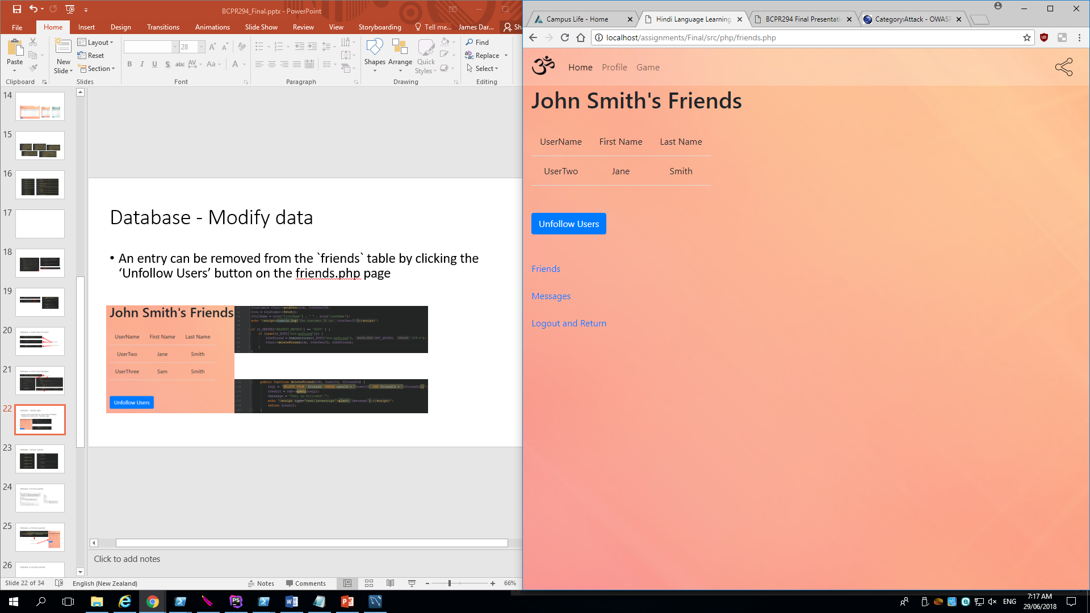
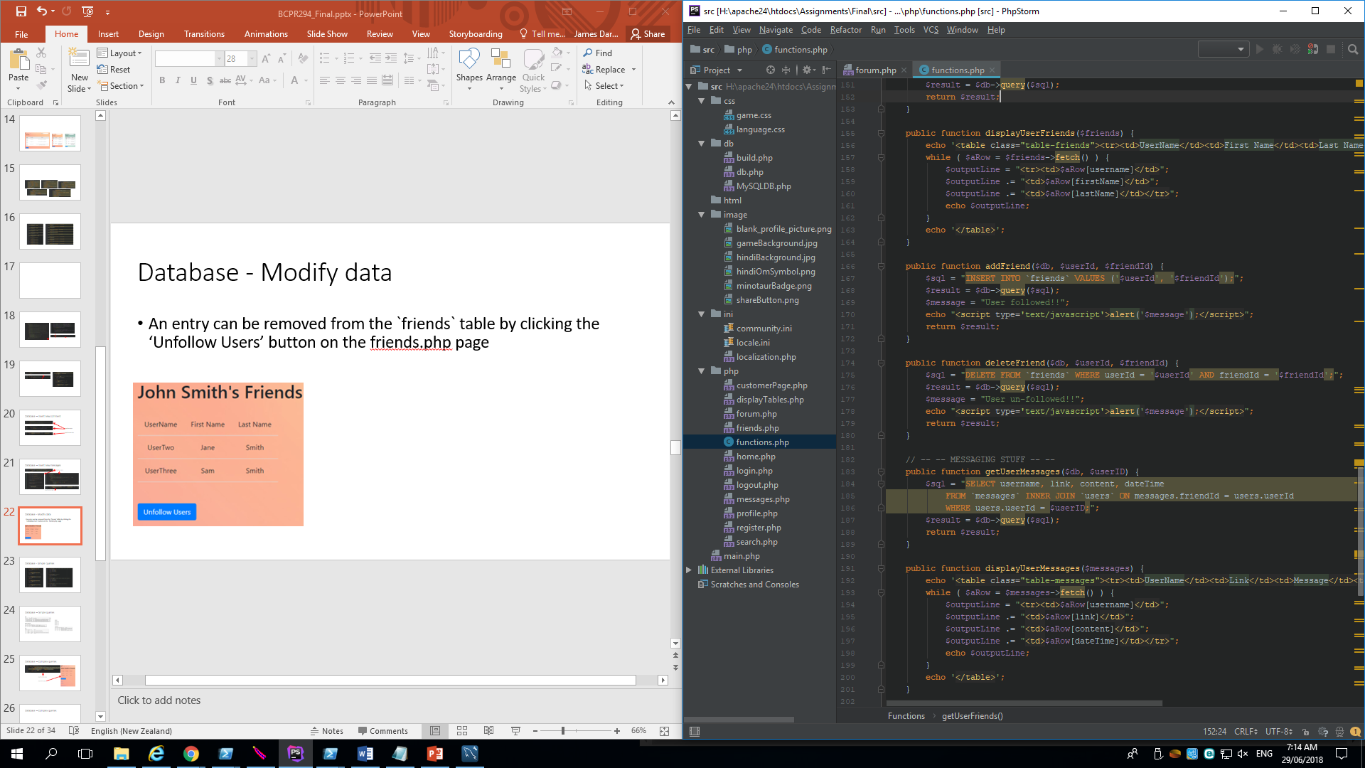
Database - Modify data
An entry can be removed from the `friends` table by clicking the ‘Unfollow Users’ button on the friends.php page
php/friends.php php/functions.php php/friends.php

Slide 24
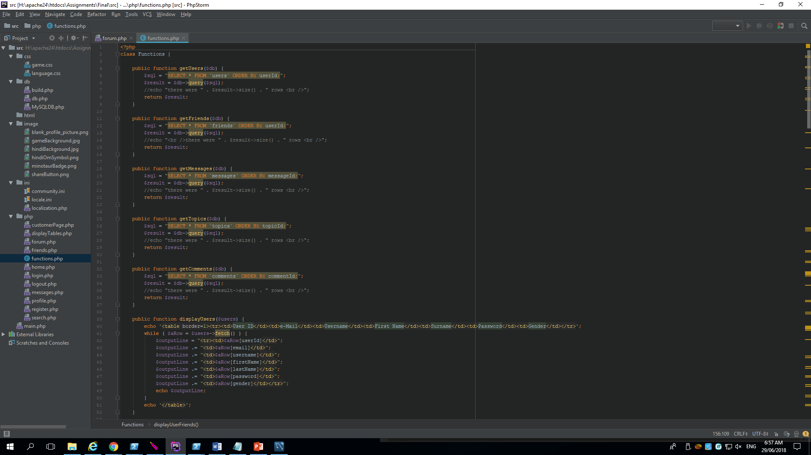
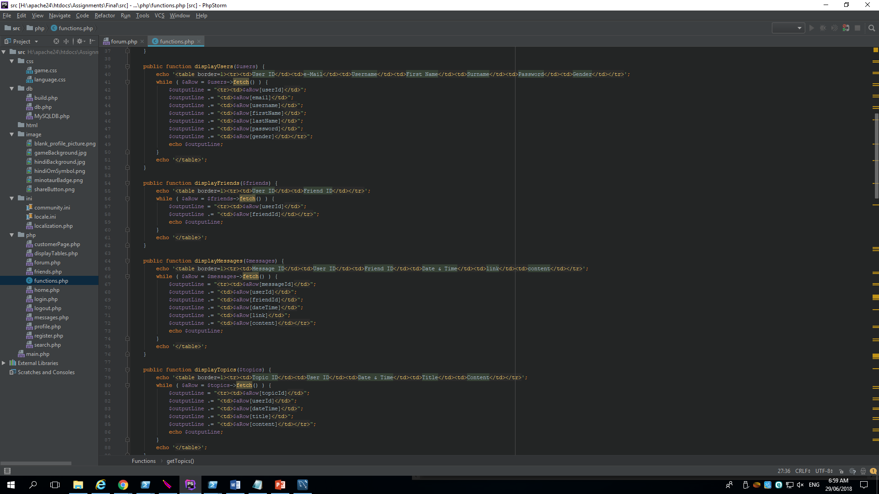
Database - Simple queries

Slide 25
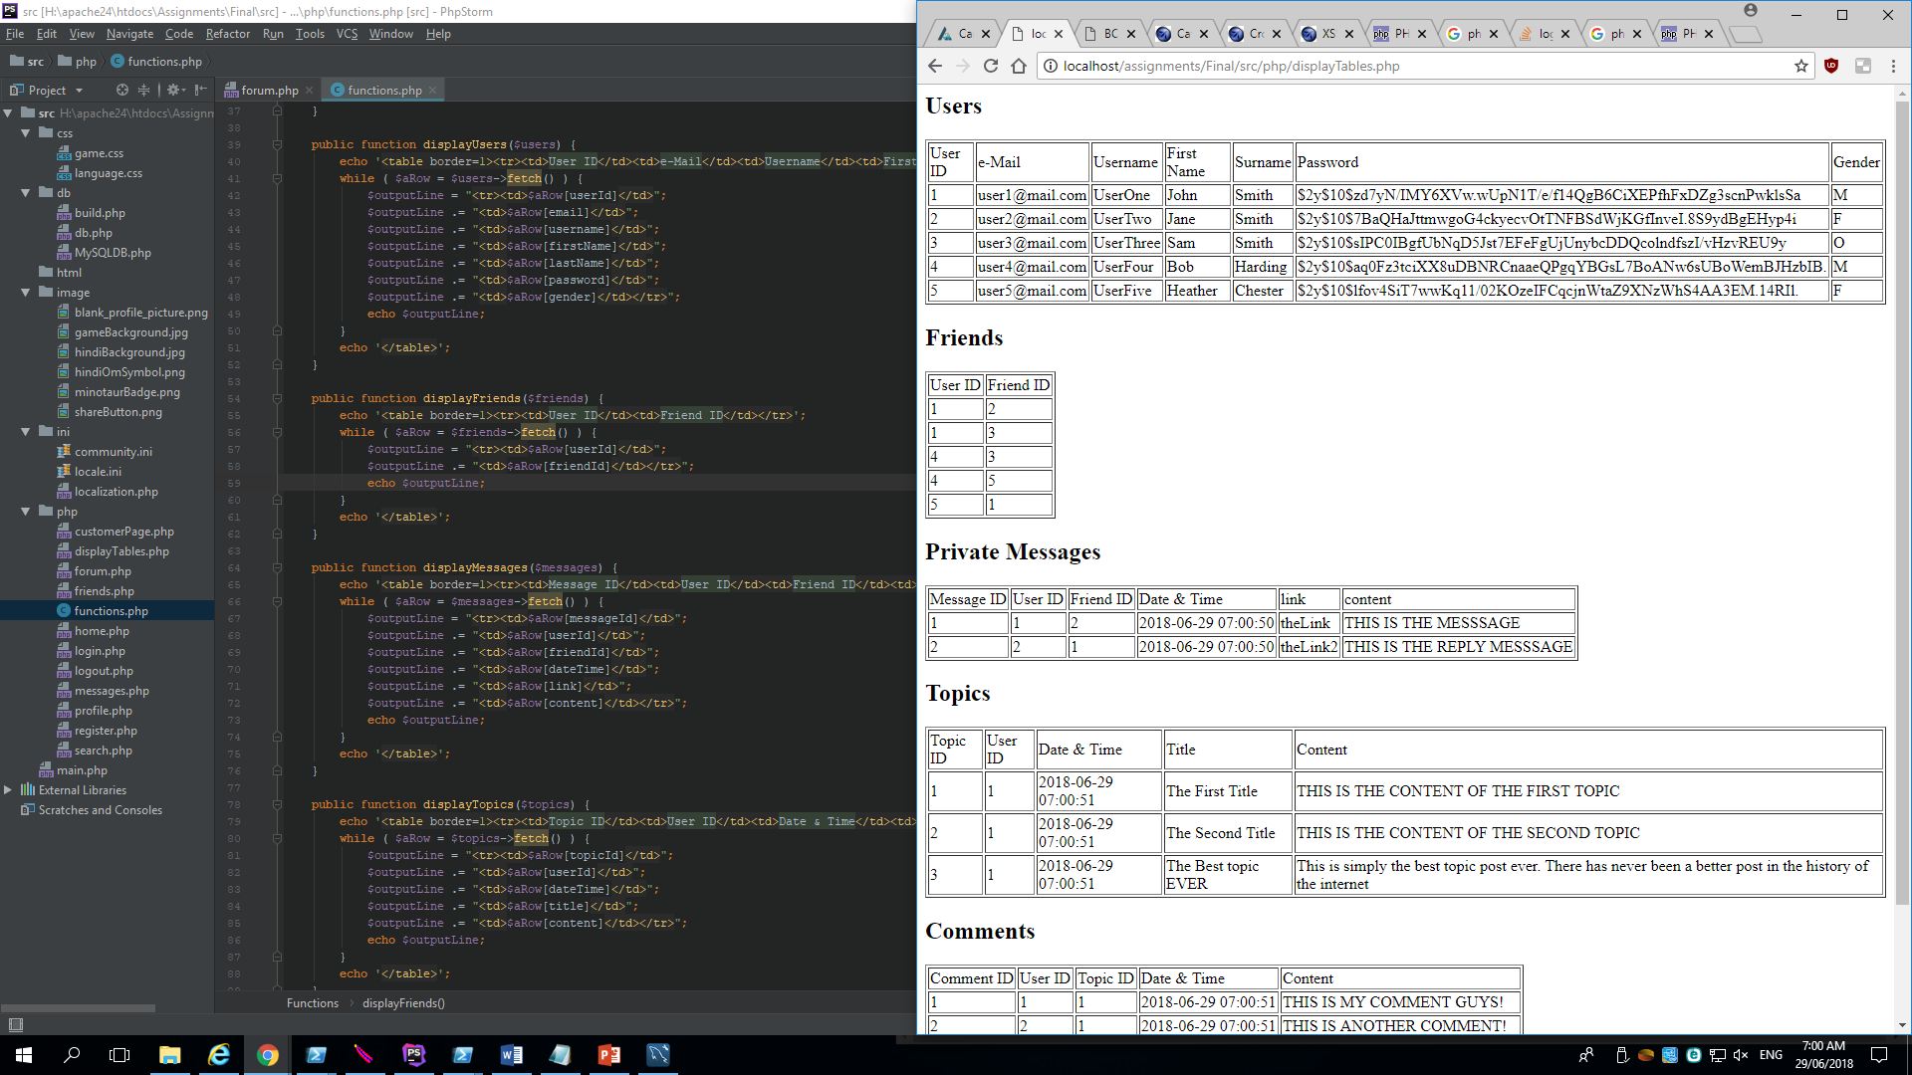
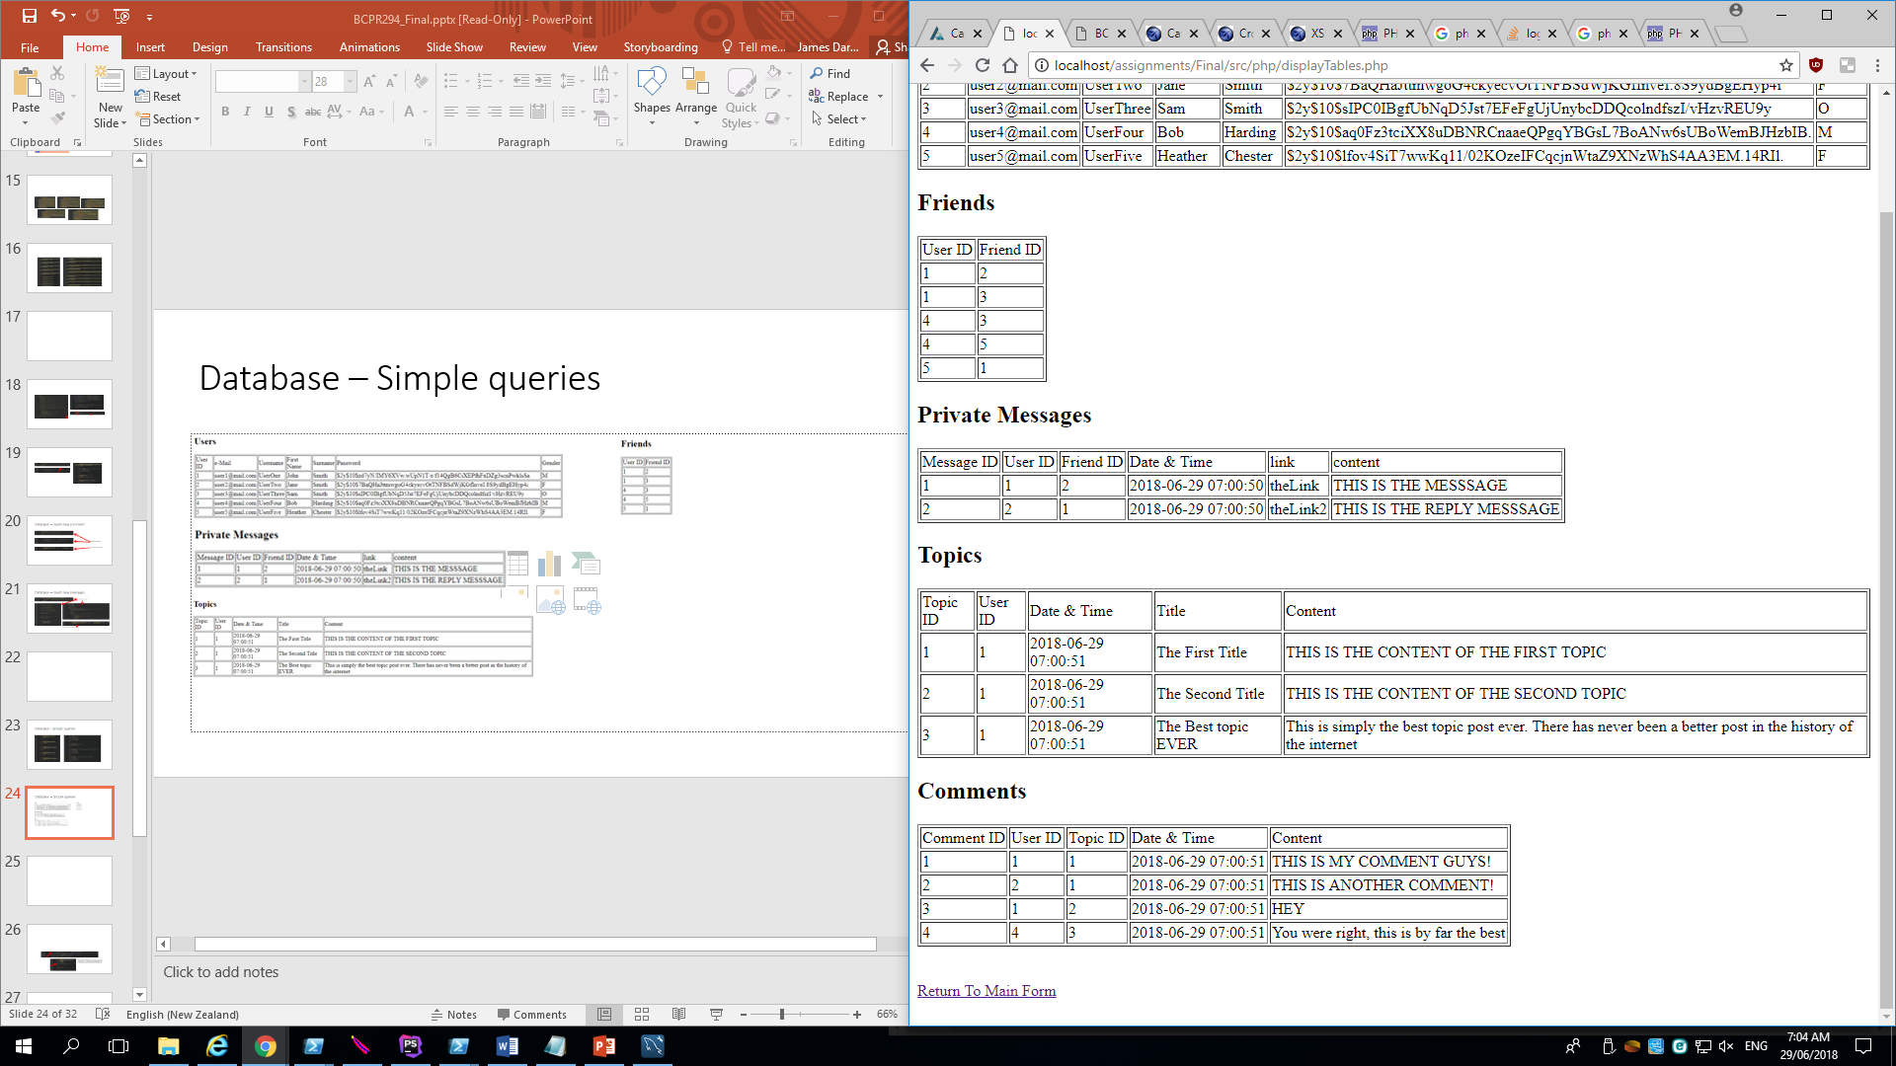
Database – Simple queries

Slide 26
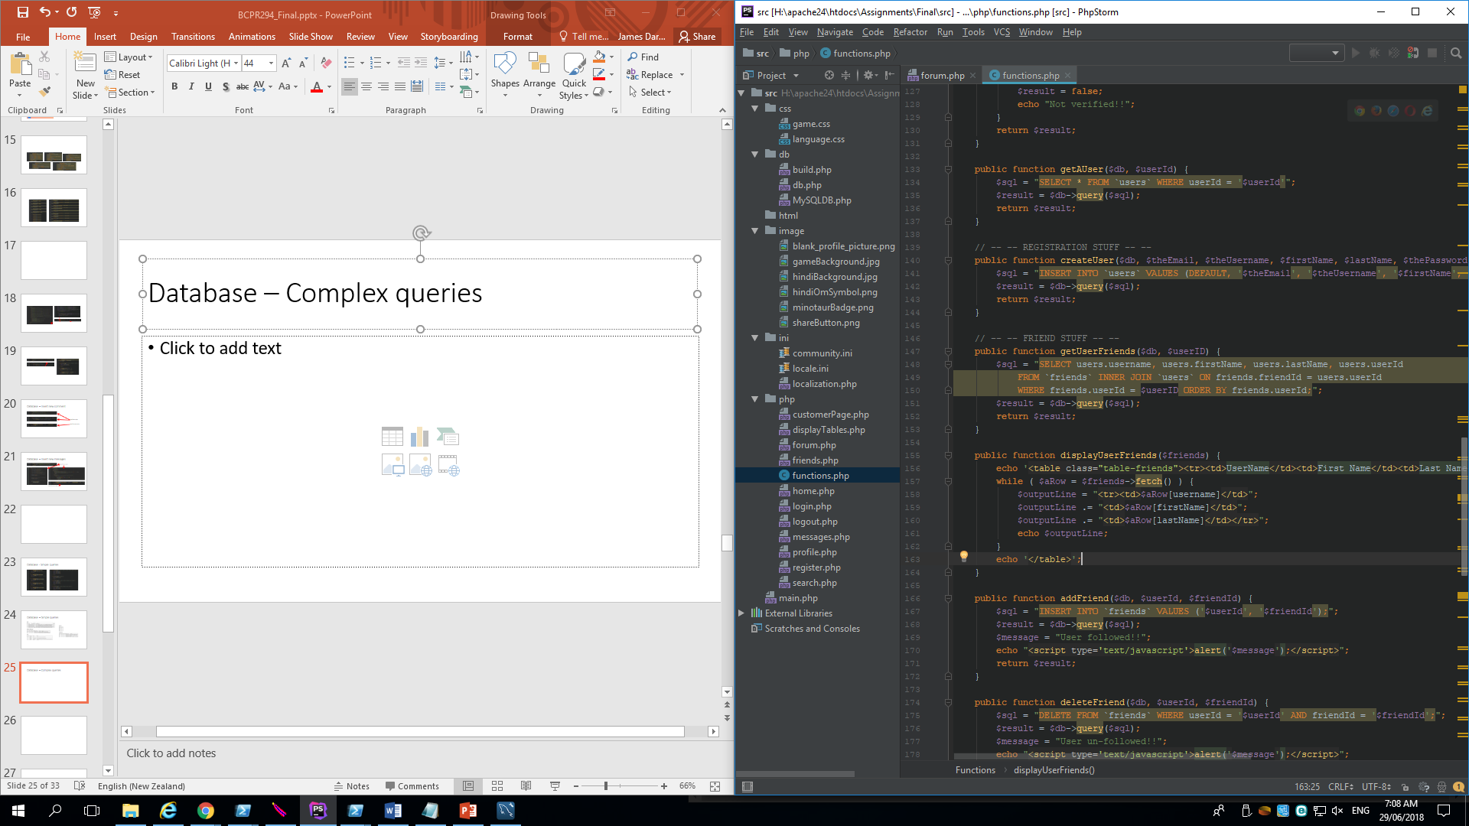
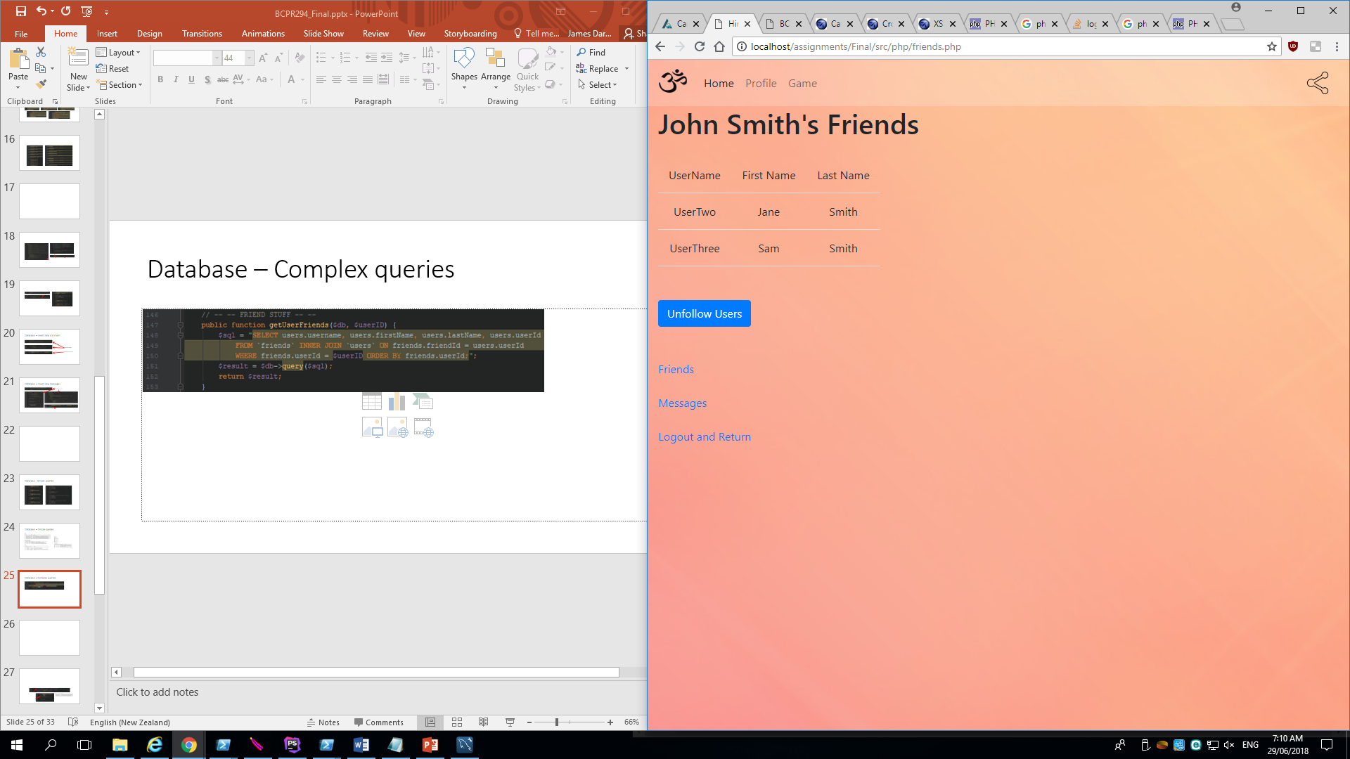
Database – Complex queries
php/functions.php
php/friends.php

Slide 27
Security
Password Hashing
SQL Injection
Cross-Site Scripting

Slide 28



Password Hashing
When registering a new user to the database using password_hash encrypts the value
The password also needs to be checked against the hashed value when logging in to the system using password_verify
php/register.php php/functions.php
Display tables – hashed passwords

Slide 29
Injection
Caused when a user “injects” a SQL query into a form used
Allows a malicious user to read, update and even remove database entries
Can be used to bypass login credentials
Injection is common against PHP applications and login screens are some of the most vulnerable

Slide 30


Injection
By entering any valid username and the string “thing' or 1=1 or 'thing” as the password this will bypass the validation
This allows a malicious user to log in to another user’s account without their password

Slide 31

Injection
This can be avoided by using password hashing to check database entries
php/functions.php

Slide 32
Cross-Site Scripting
A type of injection, occurs when a user injects a malicious script into a website
This will have an effect on potentially many other users who visit the page that the script has been injected into
Can access cookies, tokens, or other sensitive information

Slide 33


Cross-Site Scripting
Entering the string “<script>alert(123)</script>” as a comment in a forum post will cause an alert to appear
This will appear every time any user visits the page

Slide 34


Cross-Site Scripting
Can be avoided by using the php function htmlentities which converts characters to html entities
php/forum.php?1

Slide 35
SOLID – Single responsibility principle
The single responsibility principle refers to the use of classes that have unique responsibility; meaning all the functions within the class are functionally related
This makes code easier to update and maintain

Slide 36
SOLID – Single responsibility example
In functions.php, the class functions() adheres to the single responsibility principle by creating an object used to complete operations by other program components
The database connection itself is made separately in another class, ensuring operation is smooth
This could have further been improved by segmenting the classes, one for getting data from the database using an sql query, another for displaying the rows in a table. This would better suit the single responsibility principle and ensure operation and creation of classes is not confused during run time, making future expansion easier

Slide 37


SOLID – Single responsibility example
Examples from functions.php
Should be separated to fit SOLID
Could create a third class for adding and modifying database entries

Slide 38
SOLID – Open-closed princple
The open / closed principle is about creating classes open for usage and extension of functionality, but closed for modification
This can be achieved through visibility of functions and attributes, the use of interfaces or type-hinting
This adds a level of security to functions and means a class cannot easily be modified

Slide 39
SOLID – Liskov substitution principle
All subclasses created should match the interface of their base class, meaning a sub class can extend the functionality of a base class, essentially replacing it during operation
Subclasses were not implemented with this social media site as time constraints and lack of understanding stood in my way

Slide 40
SOLID – Interface segregation principle
Interfaces should be designed in such a way that the client does not need to be aware of the functions they are implementing
This means that a user should provide a program with input and should then receive an output based on their input data

Slide 41
SOLID – Dependency inversion principle
This principle is about supressing the most complex functions within a system so a user doesn’t need to directly interact with it
This principle involves identifying abstractions and decoupling them to ensure smooth program operation and a client who is aware of the functionality of the program, while being unaware of the deeper functionality behind their commands

Slide 42
Evaluation – Lessons learned
Please see evaluation.docx within the submission directory
Completed by James Darley

